Slide 1
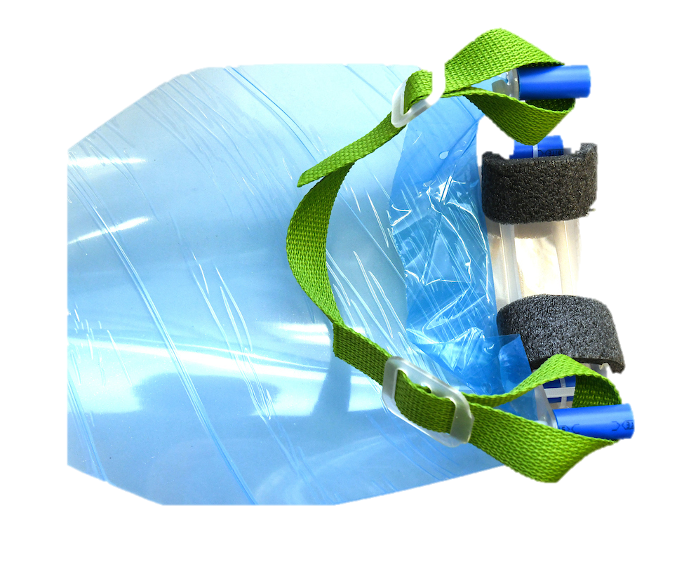
Assembly Instructions for the
Emergency Face Shield ET-02
(Rev A & Subsequent)
College of Business & Technology
Department of Engineering, Engineering Technology, & Surveying
Dr. Keith Johnson, Chair
Mr. Bill Hemphill, Associate Professor
Engineering Technology
https://www.etsu.edu/cbat/

Slide 2
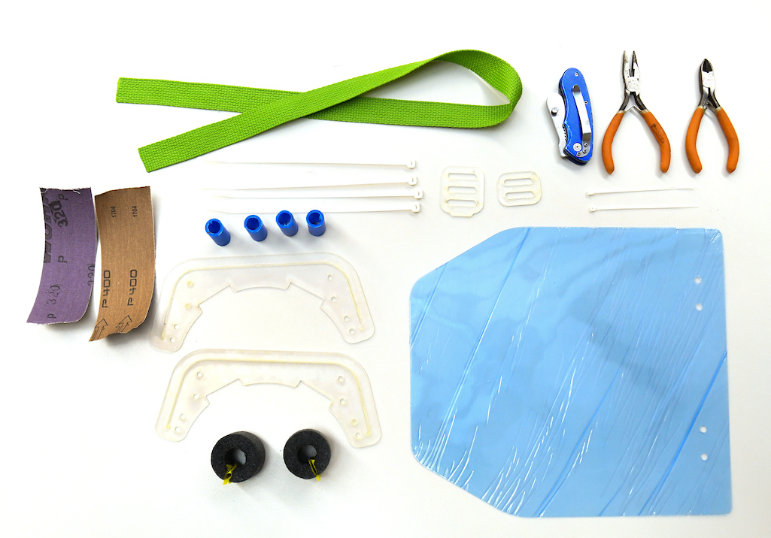
Bill of Materials
ET02 Emergency Face Shield
2 Face Shield Frame
1 Two Slot Adjustable Slider
1 Three Slot Adjustable Slider
1 Face Shield
4 1-1/8" lengths of 1/2" PEX, PVC, CPVC
4 6-½" or 8" Cable (Zip) Ties
2 4" Cable (Zip) Ties (small)
2 1-¼” length Foam Pipe Insulation (½” THK)
30" 1" or 3/4" wide Belting/Strapping
Tools
1 Diagonal or End Cutter/Nipper(s), Small
1 (Optional) Needle Nose Pliers, Small
3” 320 grit Emory cloth or sandpaper
3” 400 or higher Emory Cloth/sandpaper
1 Box Cutter, X-acto style knife, etc.

Slide 3
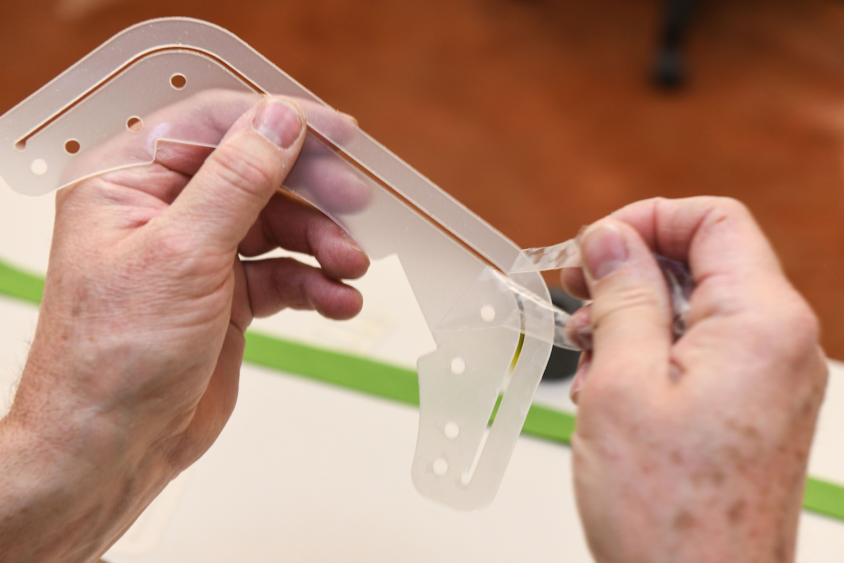
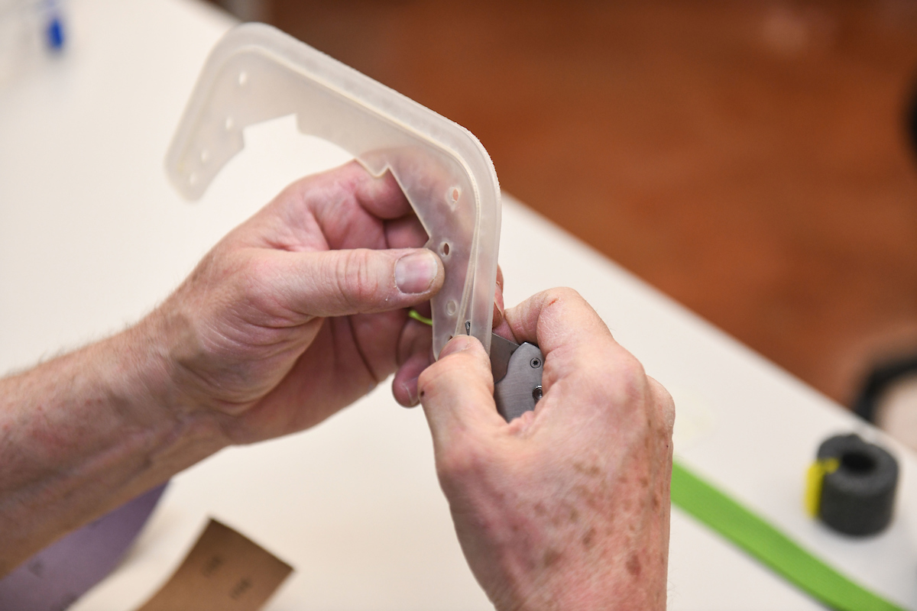
Remove Film from the Frames
Scratch off a corner and peel off the protective film on both sides of frames
Remove any material in the shield slot or holes in the frames
  Remove any material in the shield slot with a sharp knife by carefully scoring the slot edges & pressing.

Slide 4
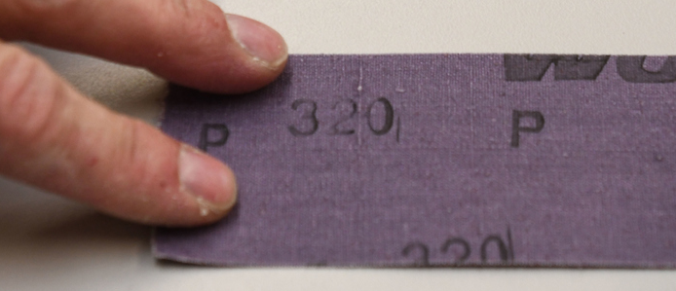
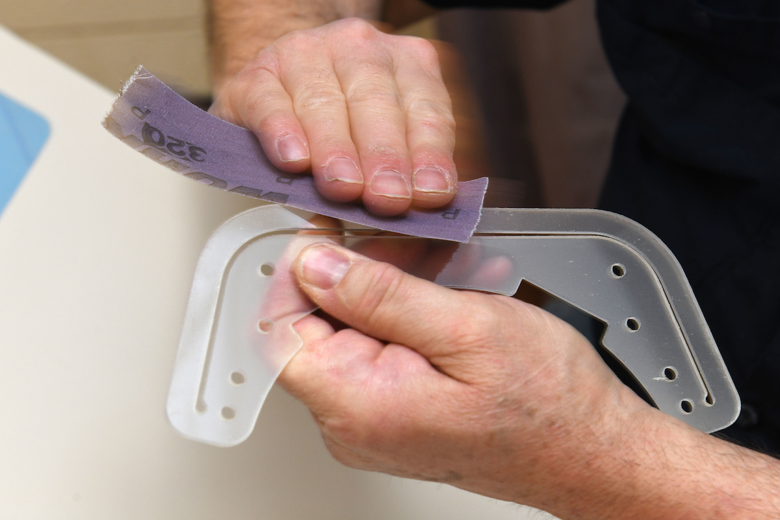
Sand Frame Edges
Smooth rough edges on each frame with 320 grit sandpaper.
  Especially the three circular arcs that would contact the forehead.
Hold sandpaper at 45 degree angle and move back and forth over both sides of each edge.

Slide 5
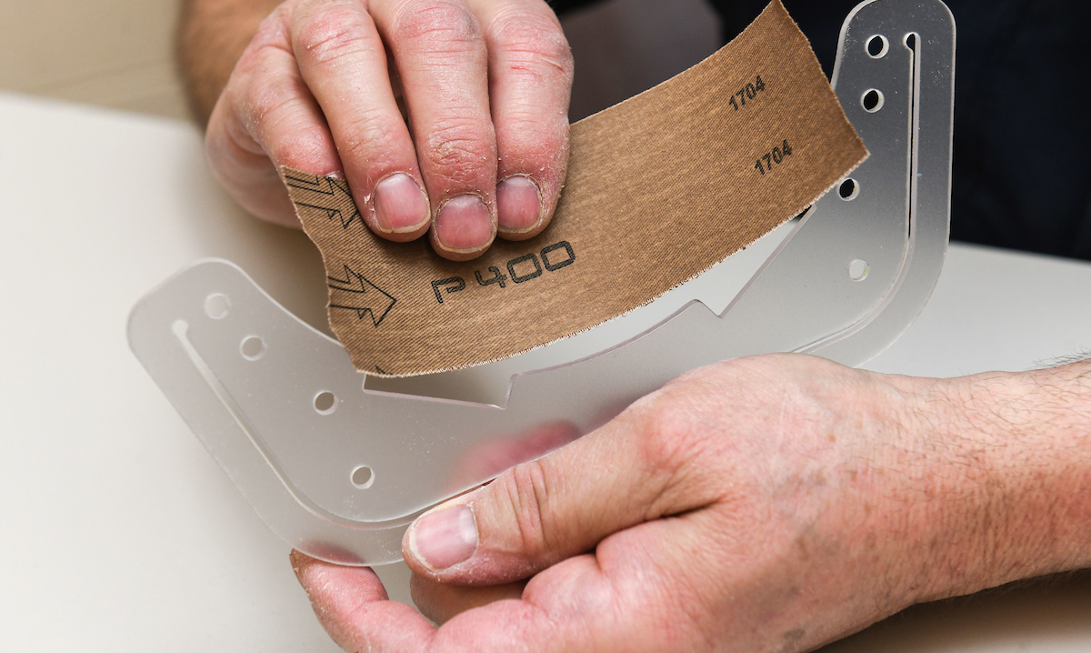
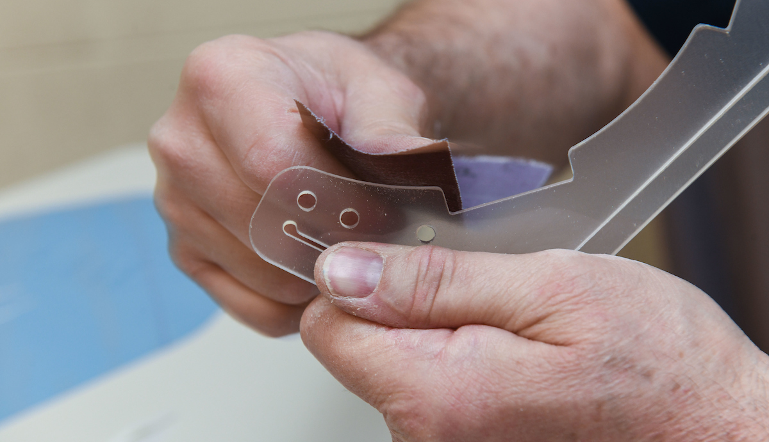
Finish Sand Frame Forehead Contact Areas
Use 400 grit sandpaper to smooth edges that may come in contact with forehead
Run you finger across contact areas to check smoothness
Continue sanding until contact areas are completely smooth

Slide 6
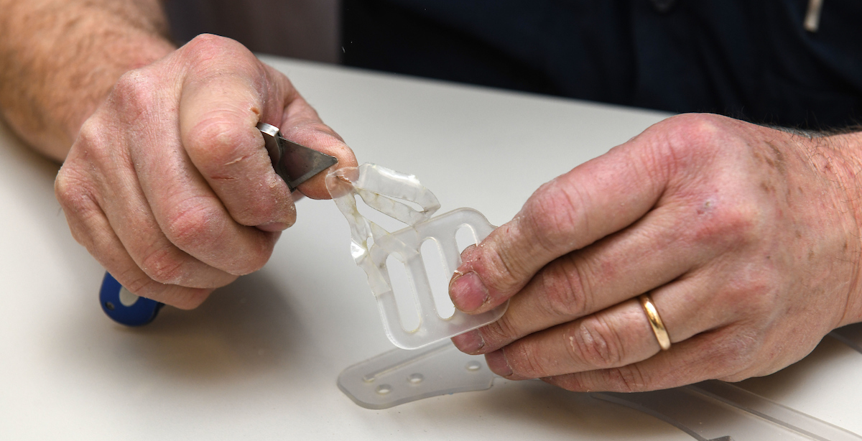
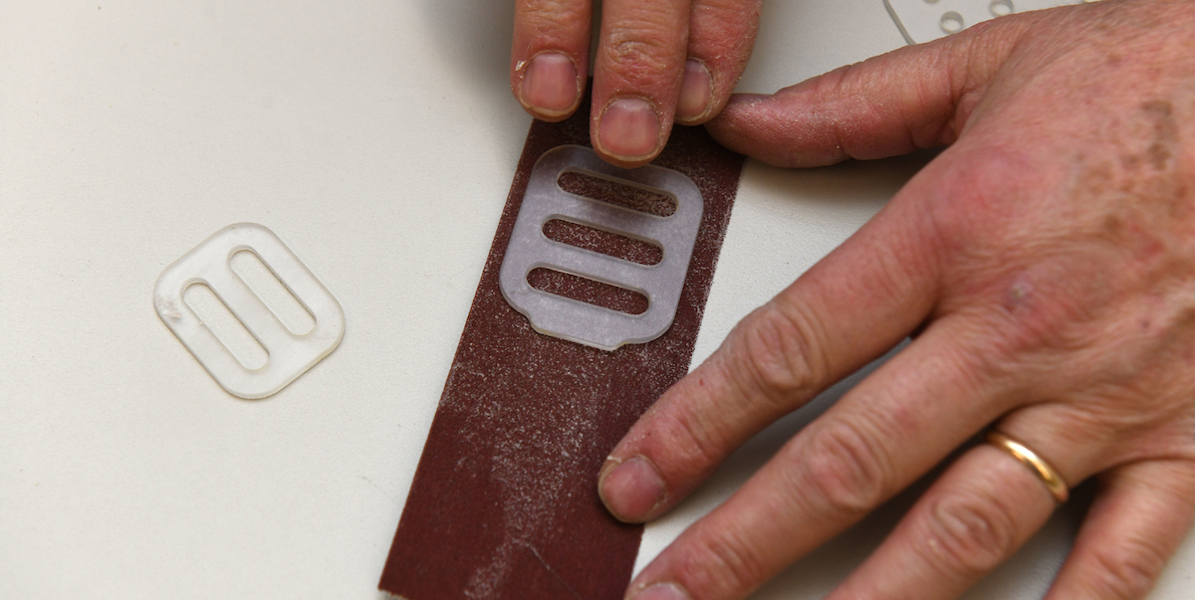
Remove Film from Adjustable Sliders
Peel off the protective film on both sides of each adjustable slider
Lay slider on 320 grit sandpaper and move back & forth to remove any high spots

Slide 7
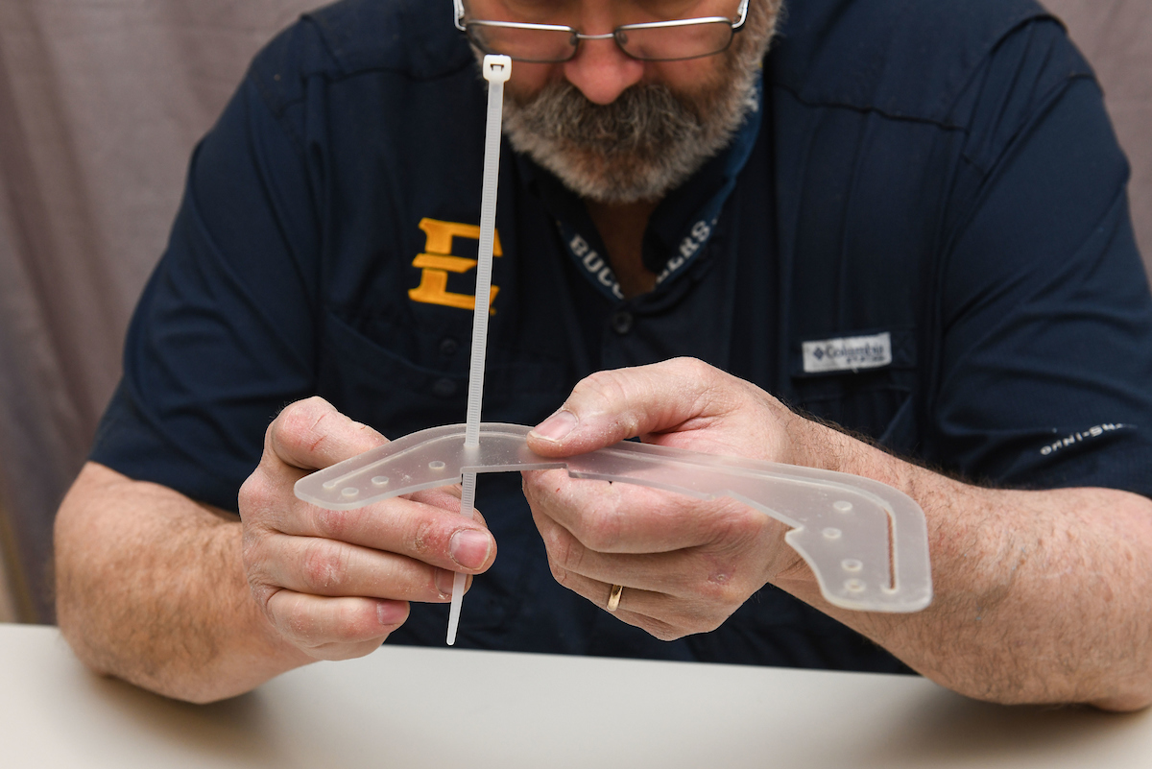
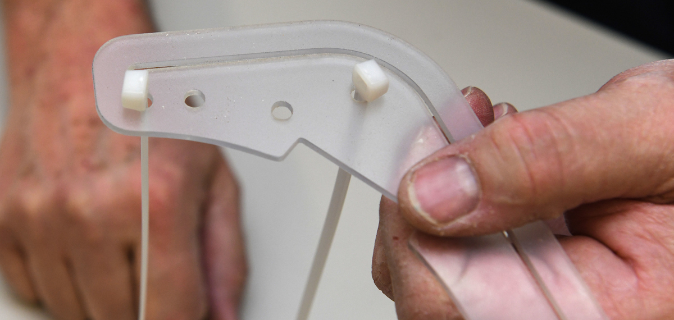
Assemble Face Shield Frame
Insert a long cable tie (“zip tie’) into each of the ‘outer’ four holes along the channel of the frame (2 per side).
  For reference, this is now the frame assembly’s “top.”

Slide 8
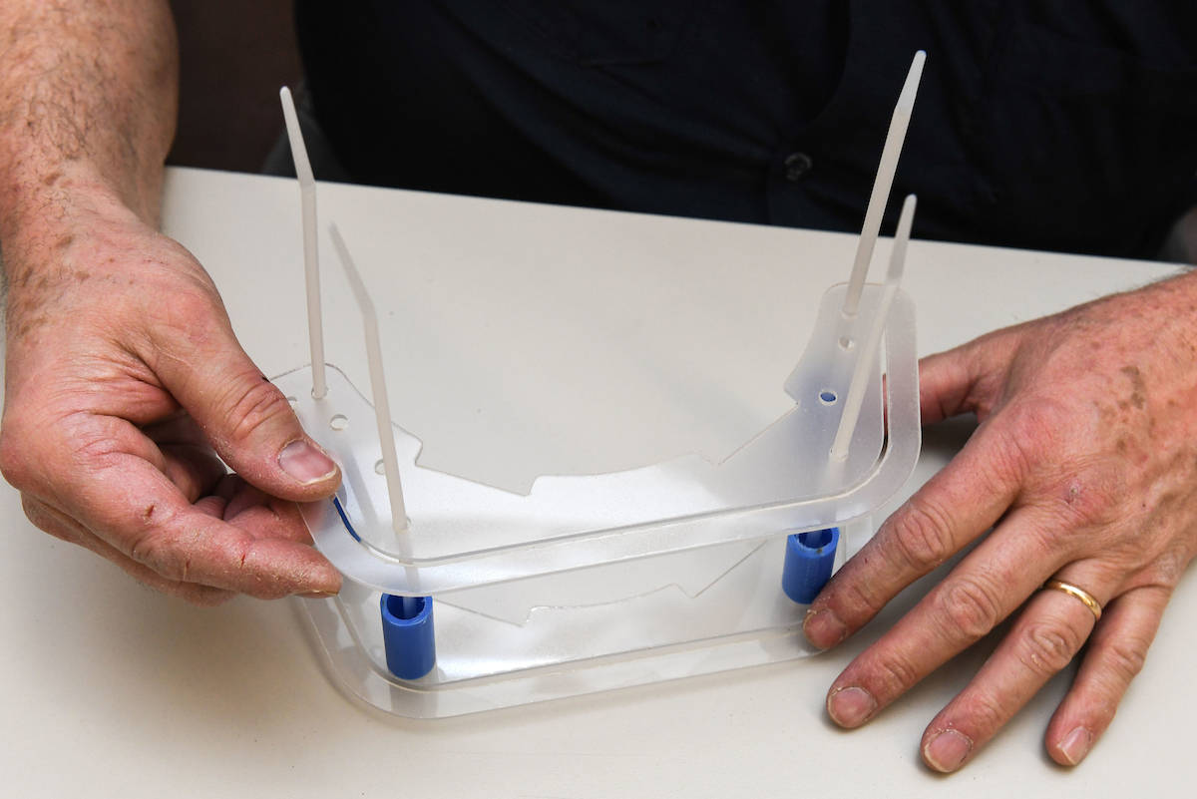
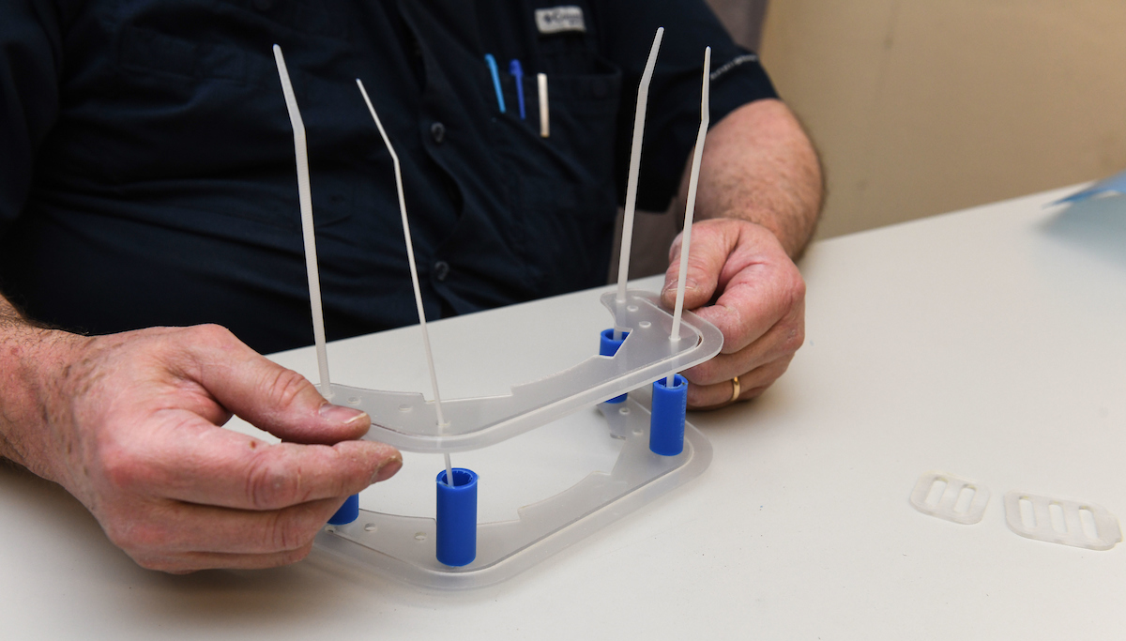
Assemble Face Shield Frame
Choose four (4) pieces of tubing that are nominally the same length.
  Deburr as required.
Slide a piece of tubing onto each zip tie… then
Line up the holes on the other frame with the zip ties and slide down until the 2nd frame sits upon the tubing supports.

Slide 9
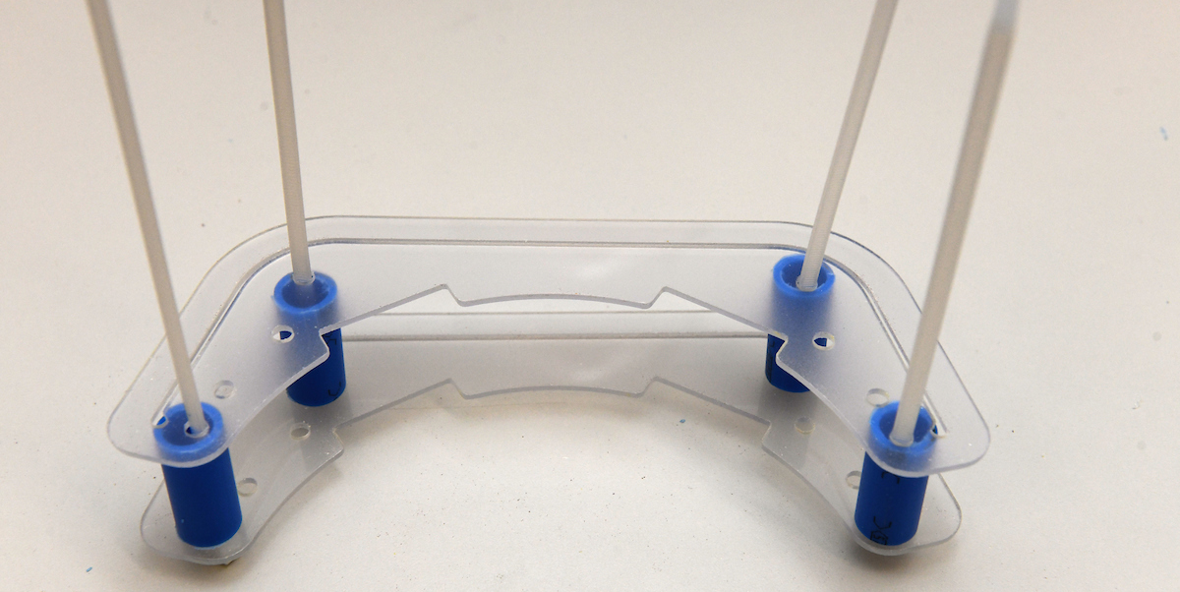
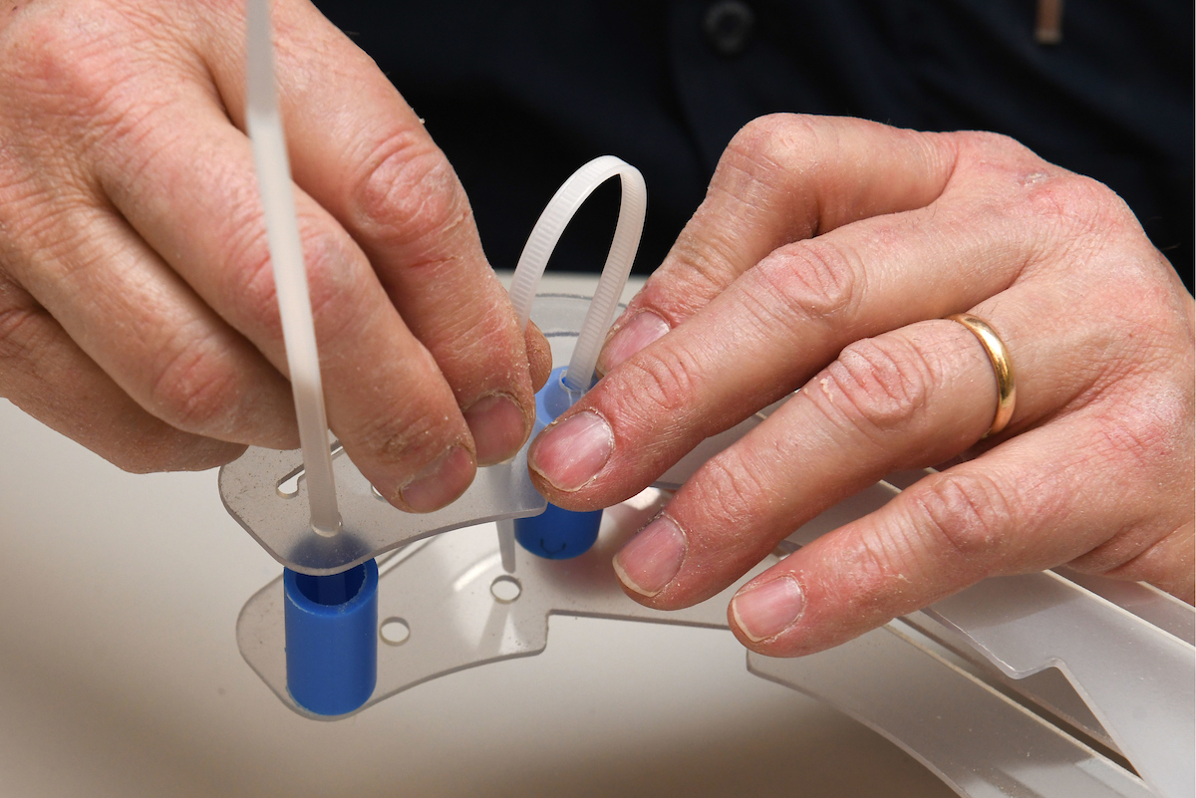
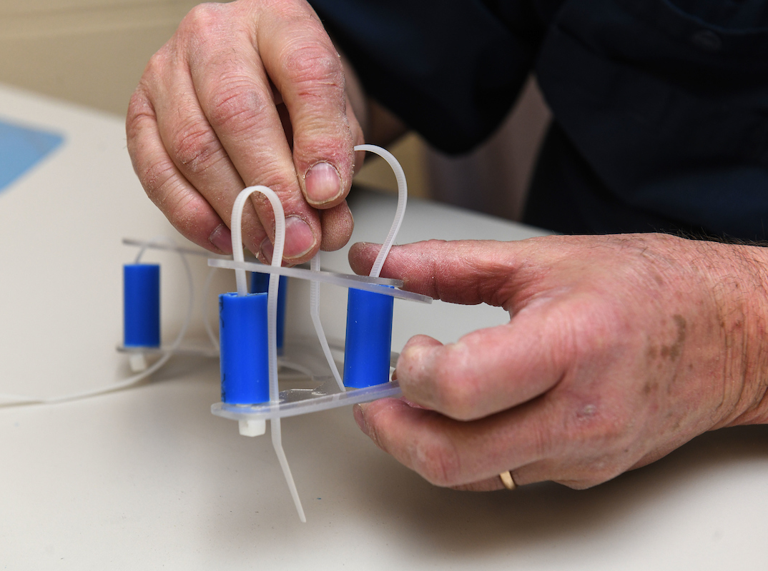
Secure Face Shield Frame
Orient the ‘head’ of the zip tie to face the adjoining hole and then on the opposite side…
Bend each zip tie and feed it into the nearest hole and continue feeding it through the second hole.
1
2
3

Slide 10
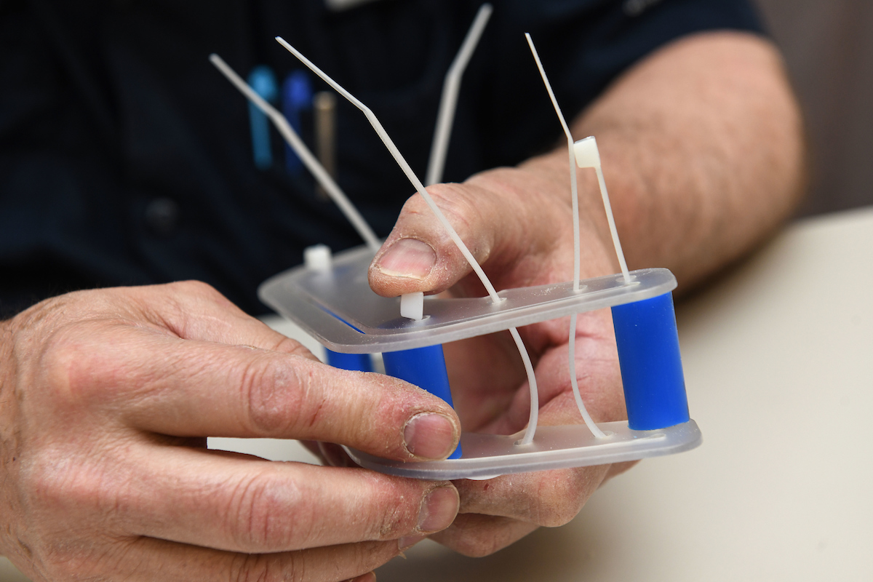
Secure Face Shield to Frame
With your thumb, press the head of a zip tie down onto the frame, then feed and pull the zip tie through (leaving plenty of slack for now).
Repeat until all four zip ties are correctly started.
Note:
Some zip ties may be oriented incorrectly (see red circle). If that happens, pull the zip tie out, reorient the zip tie head, and then feed the zip tie back through so that it can be fastened correctly.

Slide 11
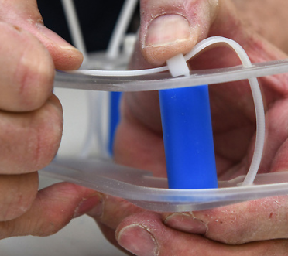
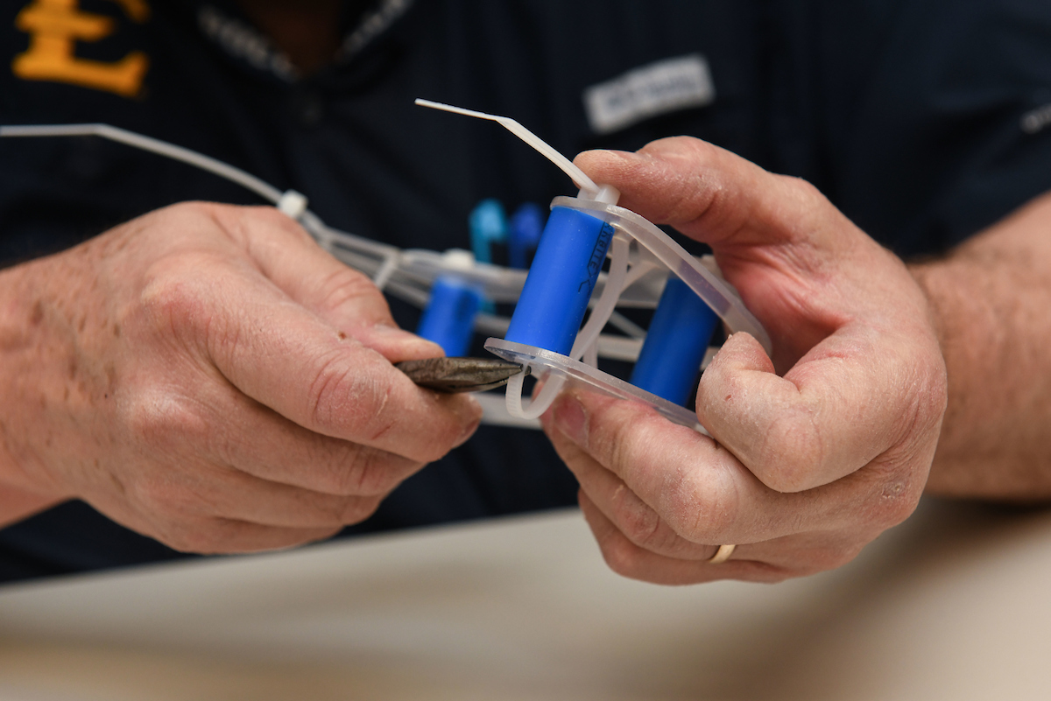
Secure Face Shield Frame
Remove the slack from each zip tie & pull tight
  #ProTip:
  Press ‘head’ with thumb onto the upper frame, squeeze the zip tie flush with the lower frame, then pull tight.
You may use a pair of needle nose pliers to carefully pull any slack, but please do not overtighten.

Slide 12
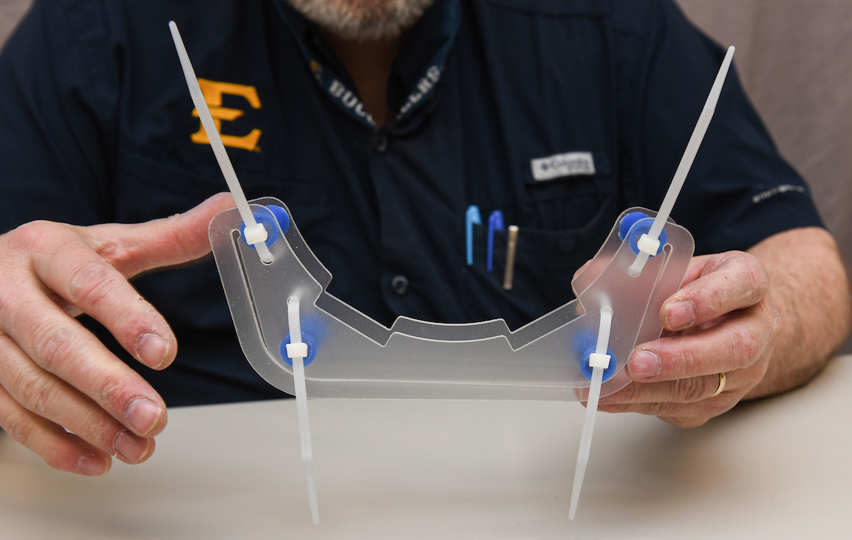
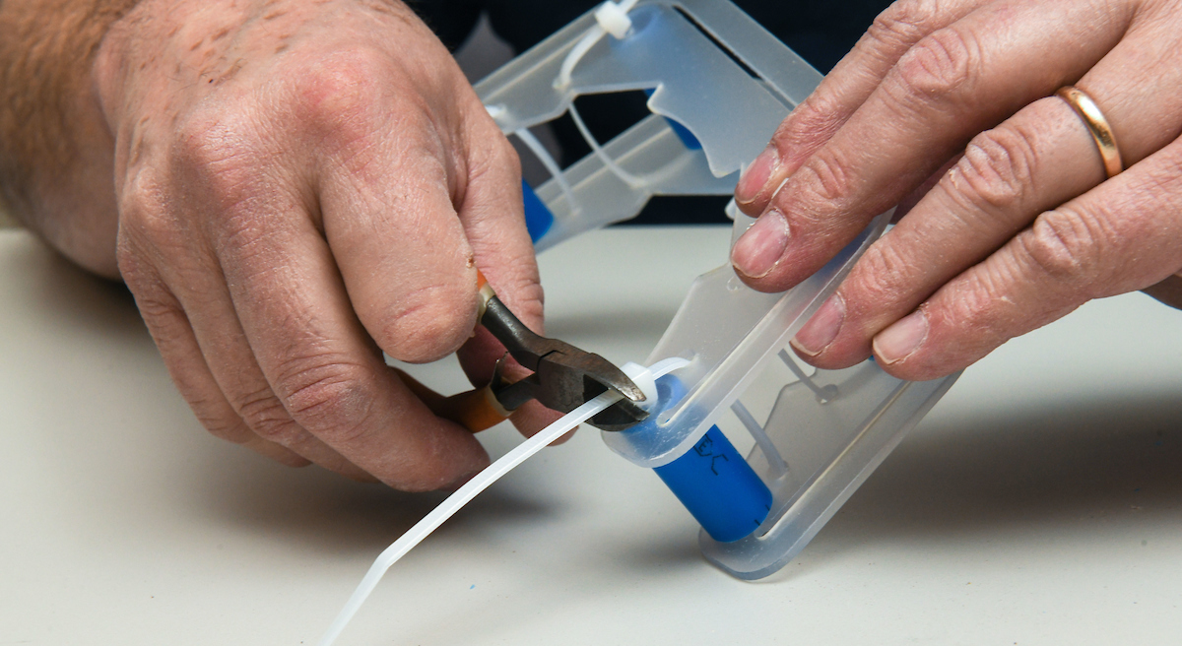
Secure Face Shield Frame
Once all four zip ties are tight & secured, use nippers (diagonal cutters) to remove the excess zip tie lengths.
  Try to make perpendicular, almost flush, cuts

Slide 13
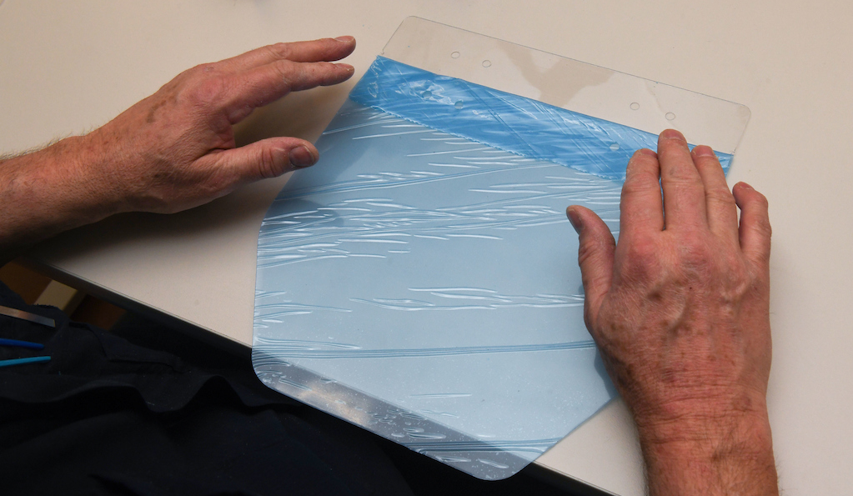
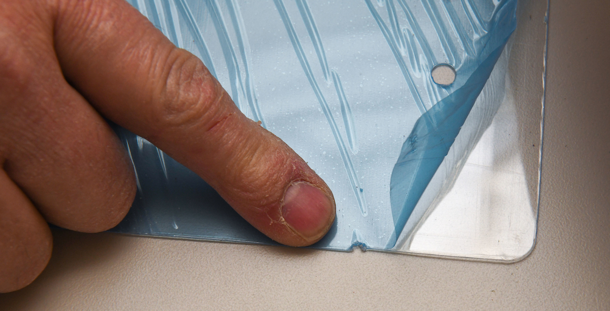
Prepare Face Shield
Starting in one of the top corners of the shield, carefully peel down any/all protective film to the side notch about 1-5/8 inches (see red circle) & STOP.
DO NOT pull off the entire protective film.
Note: Some shields may not have any protective film.

Slide 14
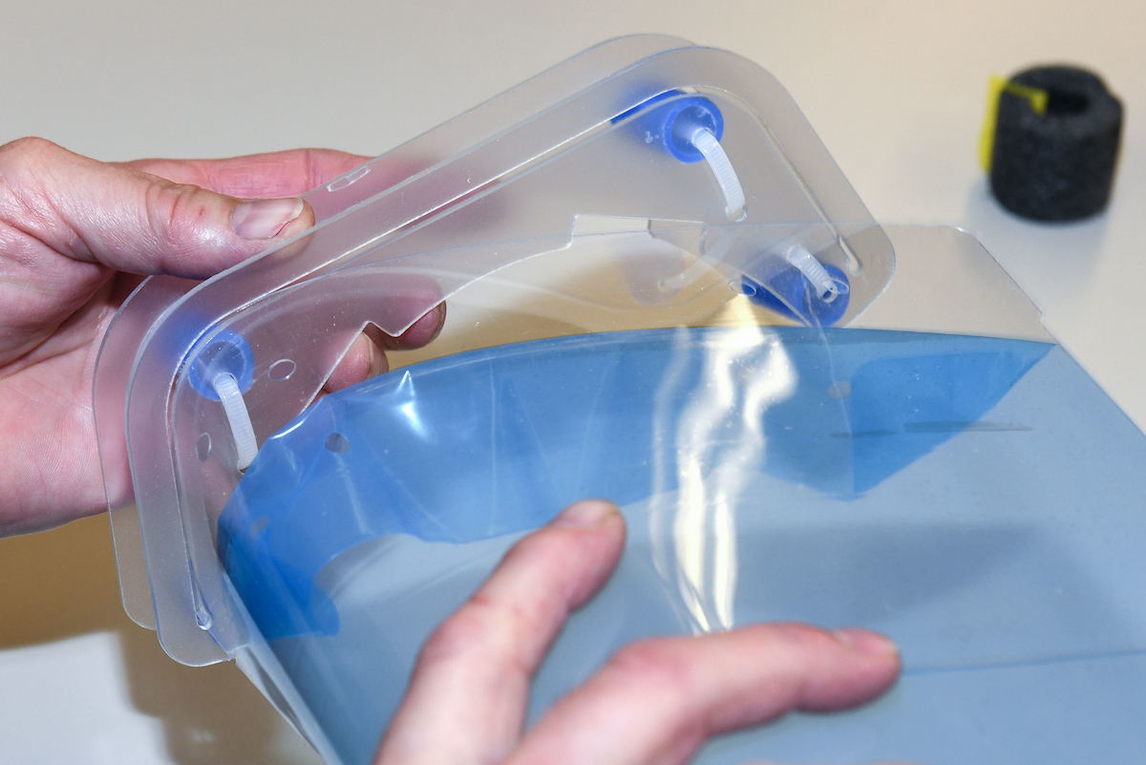
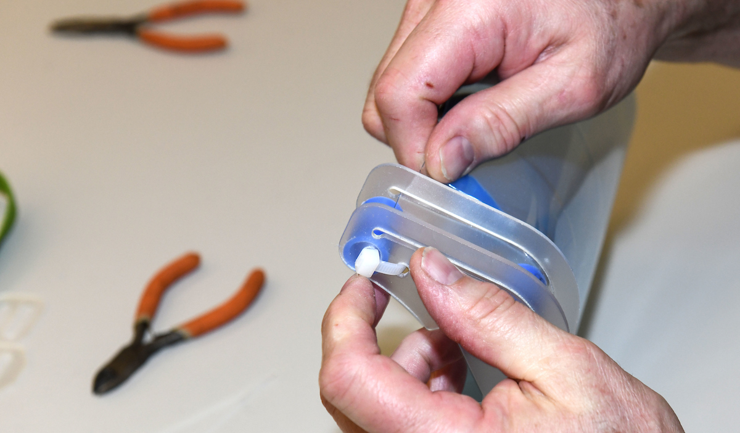
Insert Face Shield into Frame Assy
Orient the frame assembly with the top facing away from the shield.
Making sure any protective film is facing the wearer, curl the shield with your hand and
Insert the shield into the slots or channels of the frames.
  Ensure the zip tie fasteners are on top (i.e., away from the face)

Slide 15
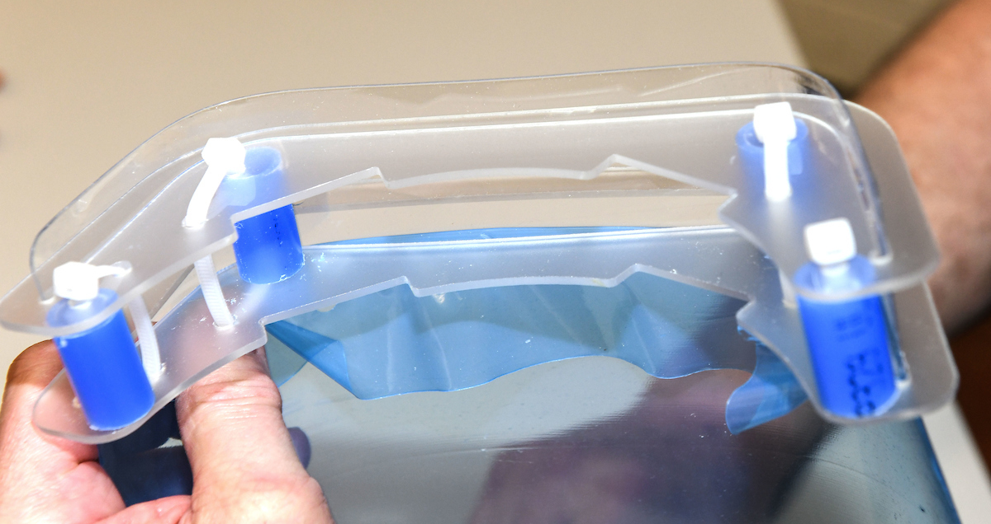
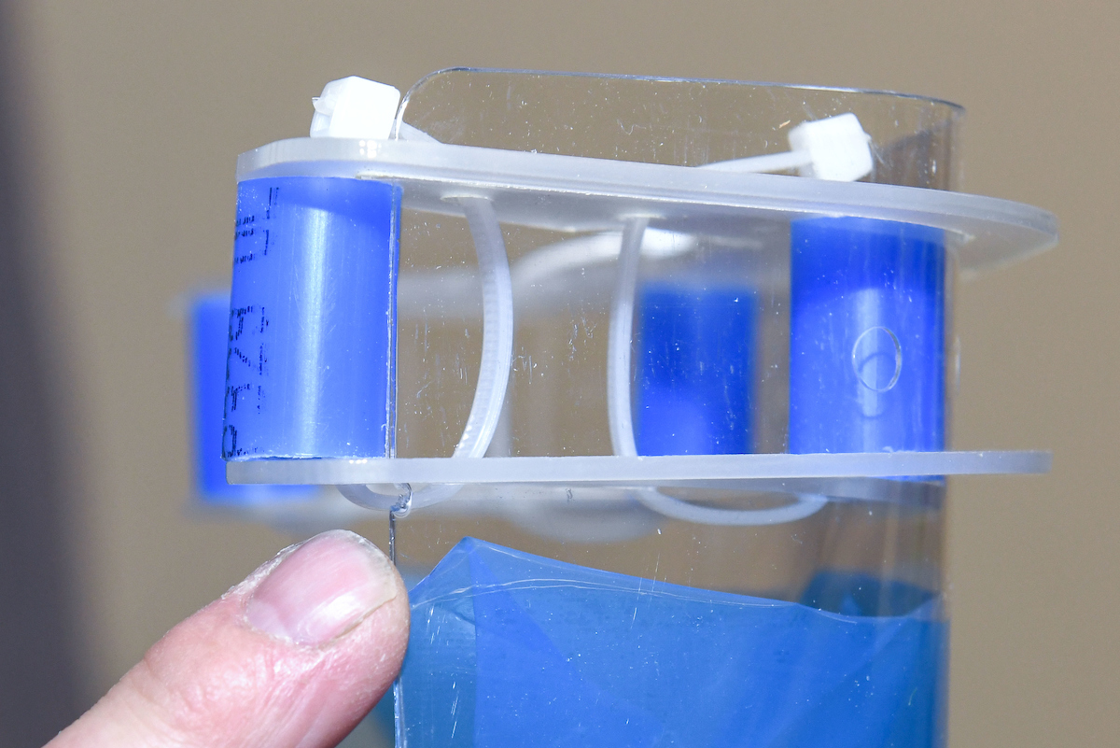
Insert Face Shield into Frame Assy
Continue working the face shield until it extends through the slots/channels of both frame pieces
  About ¼" (6 mm) of the shield will extend above the top frame
  Use the notch as a guide

Slide 16
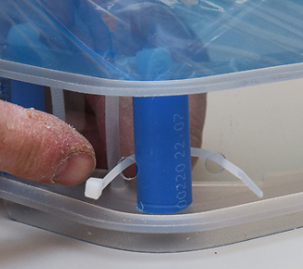
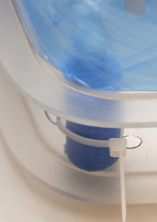
Secure Face Shield to Frame Assy
Nominally center the four holes in the shield within the frames.
Insert the short (4“) zip tie through the outer hole in the face shield, around the tubing support, back through the inner hole, and tighten. Repeat for the other side.
  Ideally, the zip tie heads will face forward when tightened.

Slide 17
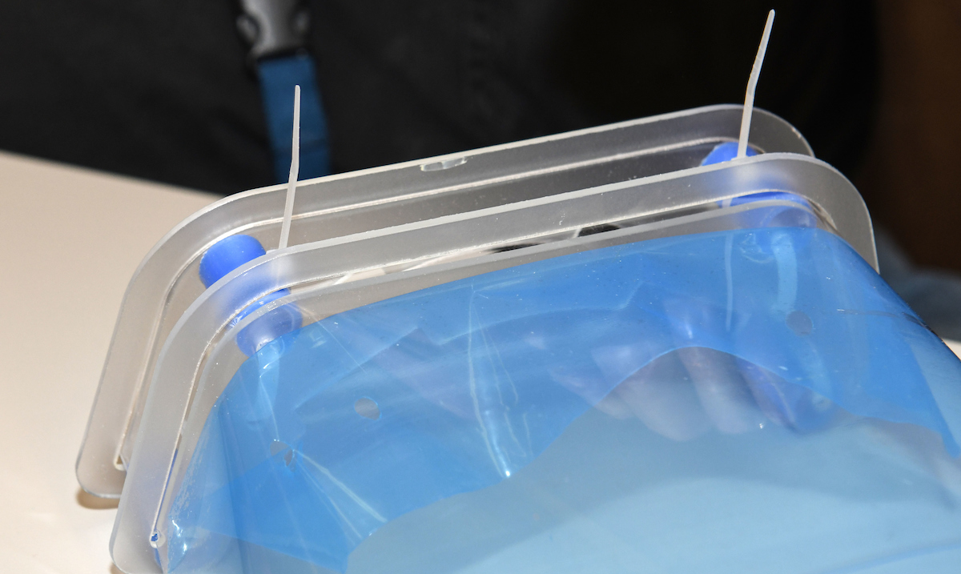
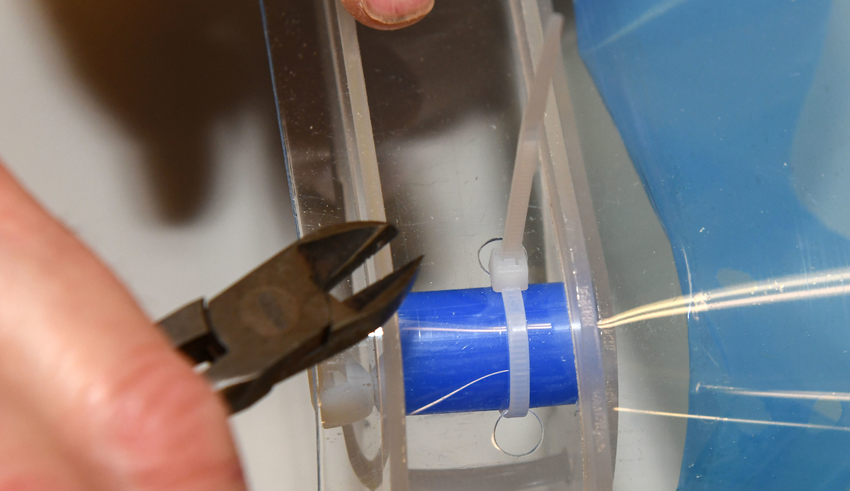
Secure Face Shield to the Frame Assy
Use the nippers/diagonal cutters to remove excess zip tie length on the front of the shield
  Try to make straight (perpendicular) cuts almost flush with the zip tie face.

Slide 18
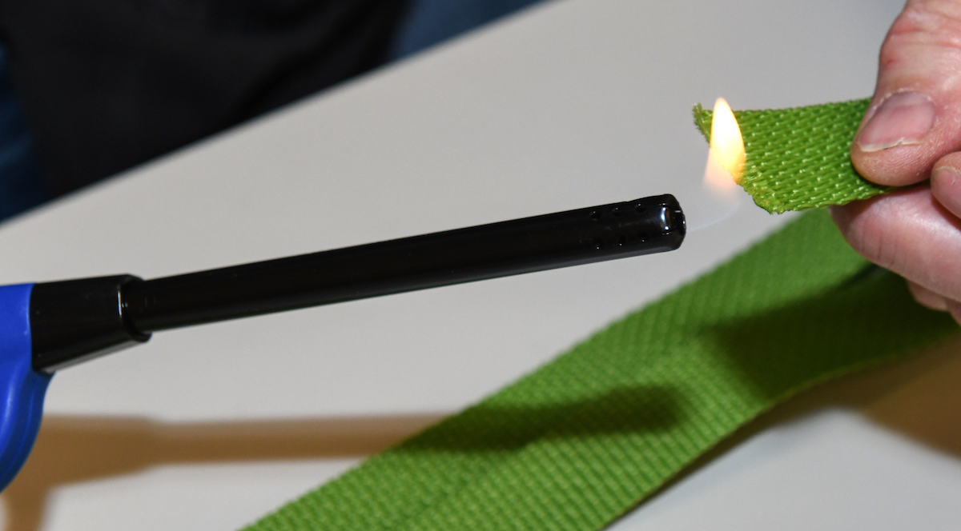
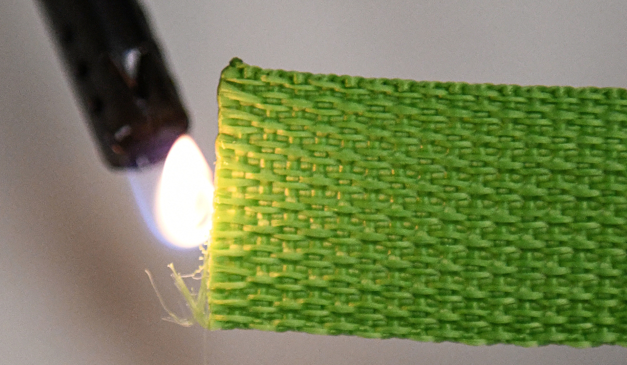
[Optional] Prepare Face Shield Strap
Only if required, heat or flame whip the end(s) of the strap
  This will prevent the strap from fraying during use.
  Move the flame across the end(s).
  Use extreme caution with open flame; do not catch the strap on fire.
  Alternative method: Use a soldering iron

Slide 19
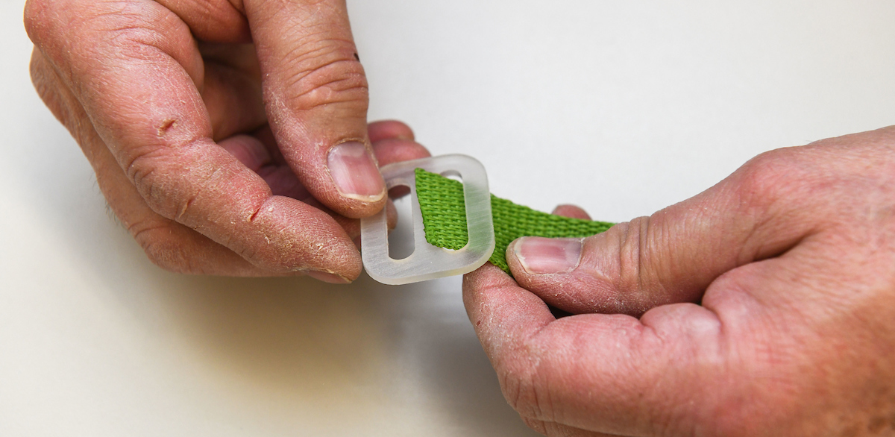
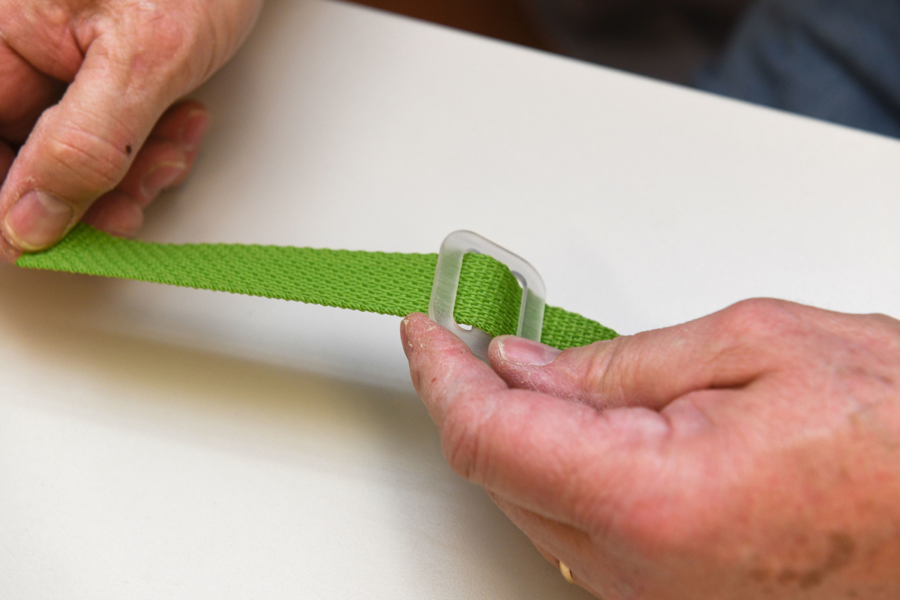
Prepare Face Shield Strap
Insert the right end of the strap into the two (2) slot adjustable slider piece (under/over/under).
Position the slider approximately one third (1/3) of the way down the nominal 30” inch strap

Slide 20
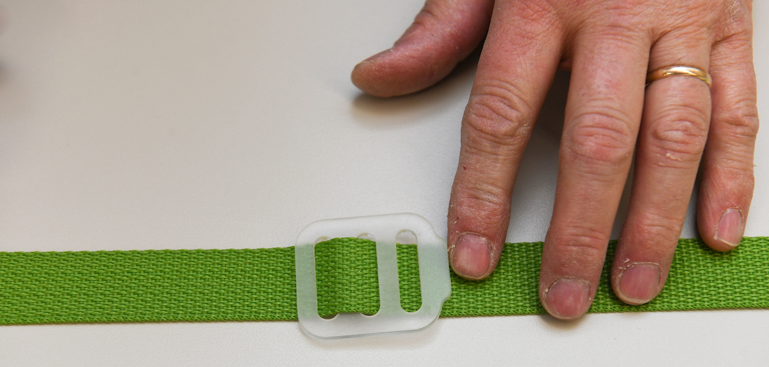
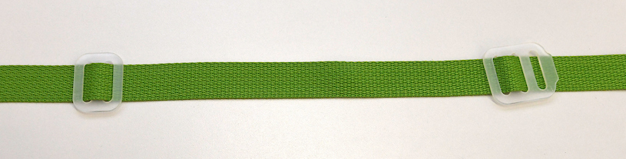
Prepare Face Shield Strap
Orient the three (3) slot adjustable slider with the ‘tab’ facing to the left.
Insert the left end of the strap into the 3 slot adjuster under the right-most bar, over the next bar and then under the next bar.
Position the slider nominally one third (1/3) of the way down the strap

Slide 21
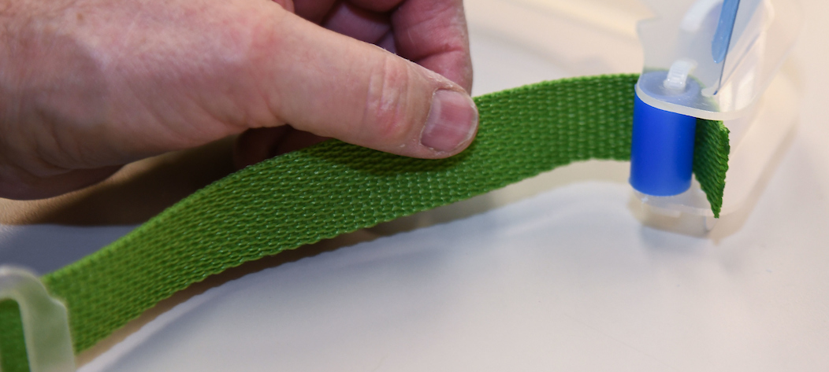
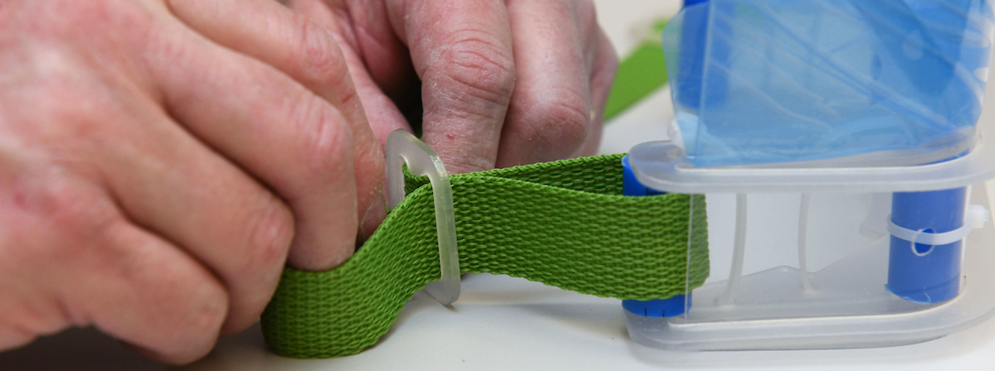
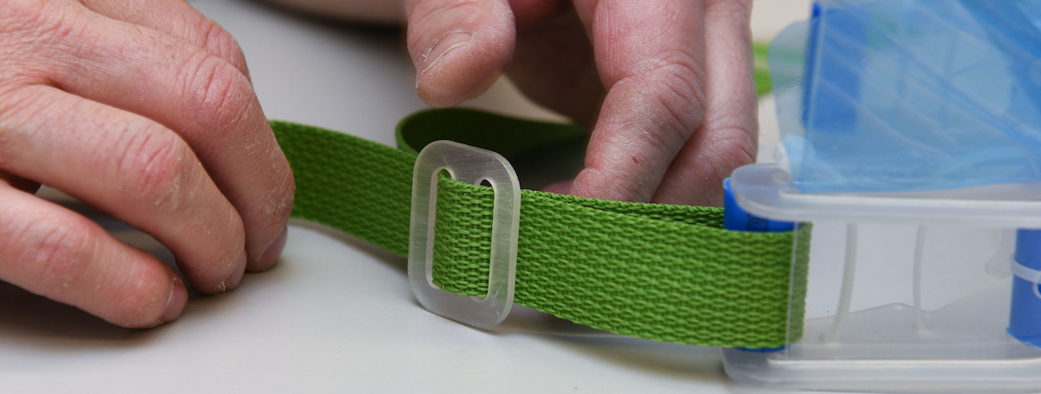
Attach Face Shield Strap—Right Side
Stand the face shield assembly on end facing away from you.
Feed the right end of the strap (with the dual slot slider) tightly behind the R/H support tubing and pull through.
  Avoid the zip tie
Feed the free end of the strap underneath, over and through the slider

Slide 22
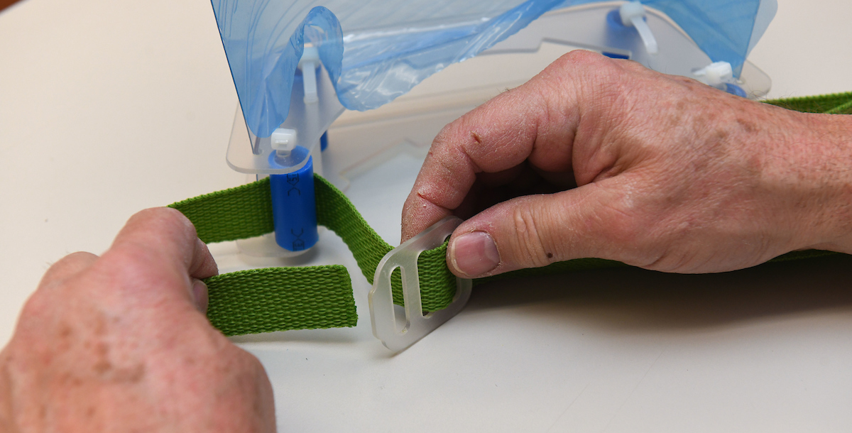
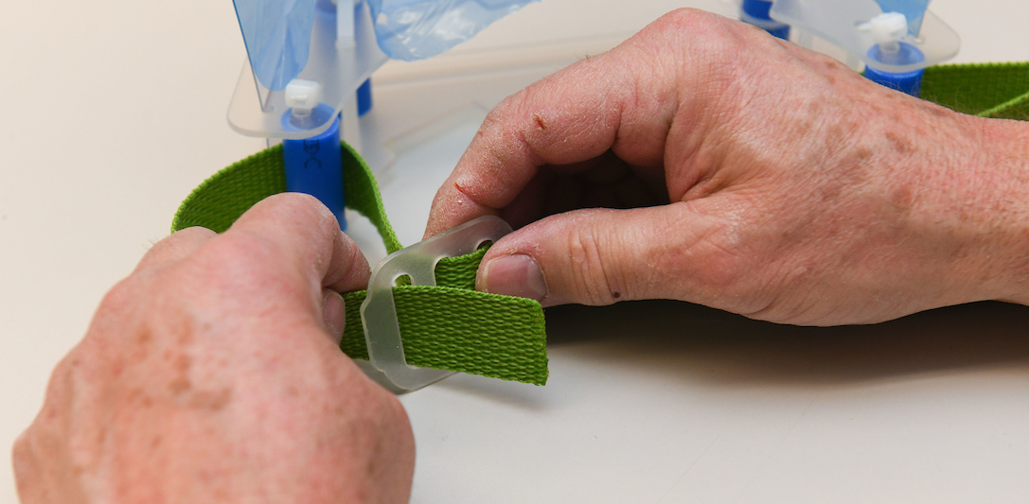
Attach Face Shield Strap—Left Side
On the left side, repeat the process feeding the free end of the strap between the support post and zip tie & shield and under the (forward) tab of the triple slot slider, over, and then under the rear-most bar (under thumb)
Tighten the strap and position the sliders approx. 3“ from the frame with each side showing approx. 3" of free end.

Slide 23
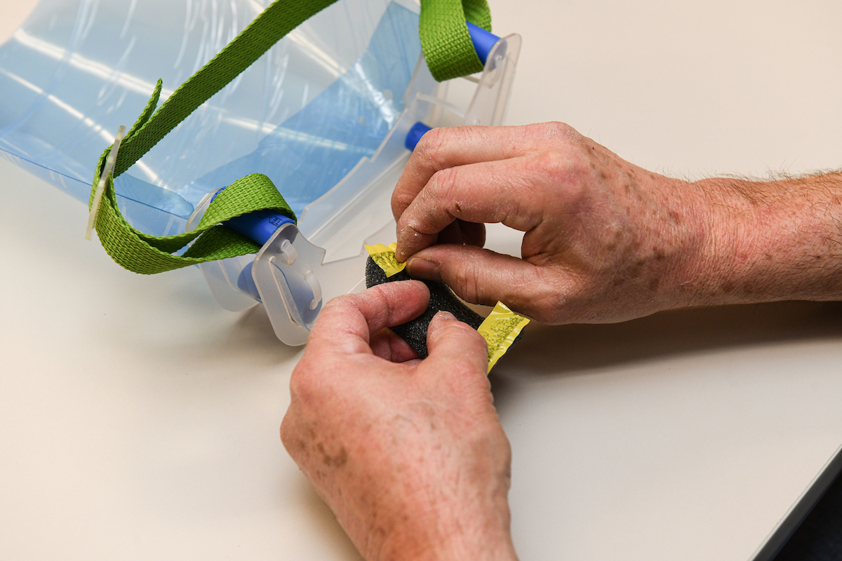
Attach Bumpers to Face Shield Frame
If there is adhesive on the edges of the split foam bumper pieces, remove protective film from one side.
ProTip:
Peel from the inside out; it just releases easier.

Slide 24
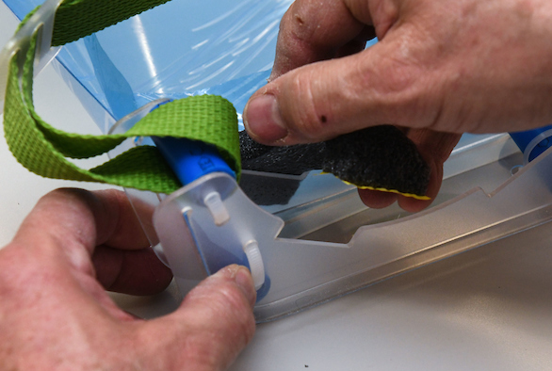
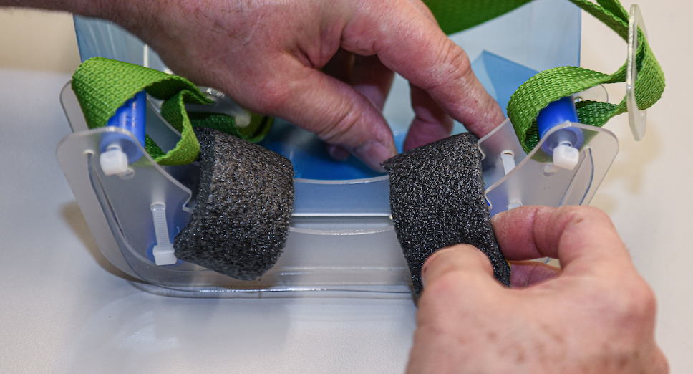
Attach Bumper to Face Shield
Center foam bumper within the slots on the inside of the face shield and then secure the other split foam bumper end to the opposite frame.
Ensure that the bumpers extend beyond the frame edge to contact the forehead first.

Slide 25
Face Shield Assembly Complete
You are done.
Thank you.
If you are provided any type of stickers, please apply them to the shield between the frame pieces.

Slide 26
For more information:
Engineering Data Repository:
https://www.etsu.edu/coronavirus/maker-project/face-shield-files
The Emergency Face Shield project was just one of many responses
to the Spring 2020 Covid-19 outbreak by the extended community
of ETSU administrators, faculty, staff, & students.
For more information, visit https://www.etsu.edu/coronavirus/
Emergency Face Shield Project—ETSU Contacts:
Mr. Andrew Worley, Director of Emergency Management
worleyp@etsu.edu
https://www.etsu.edu/safety/emergency_preparedness
Dr. Keith Johnson, Chair
johnsonk@etsu.edu
Engineering, Engineering Technology, & Surveying
ETSU Privacy Policy ETSU Non-Discrimination Policy

