Slide 1
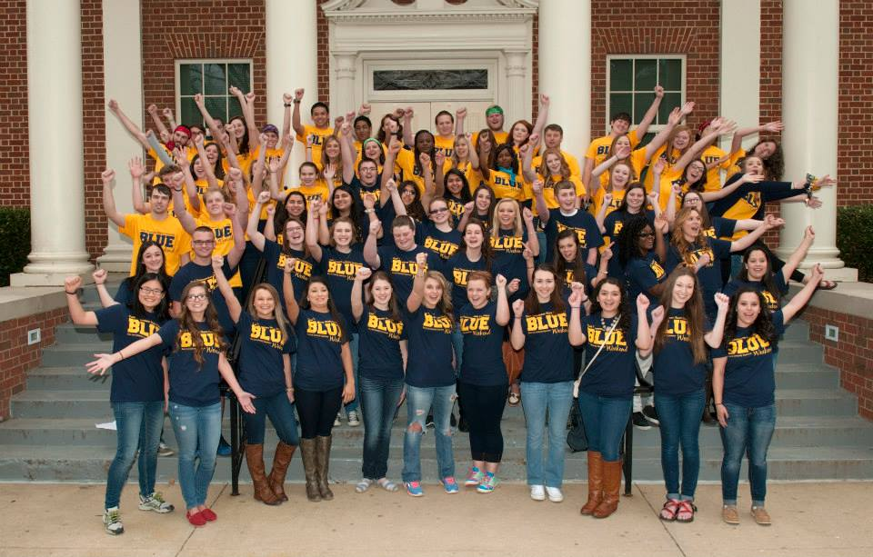
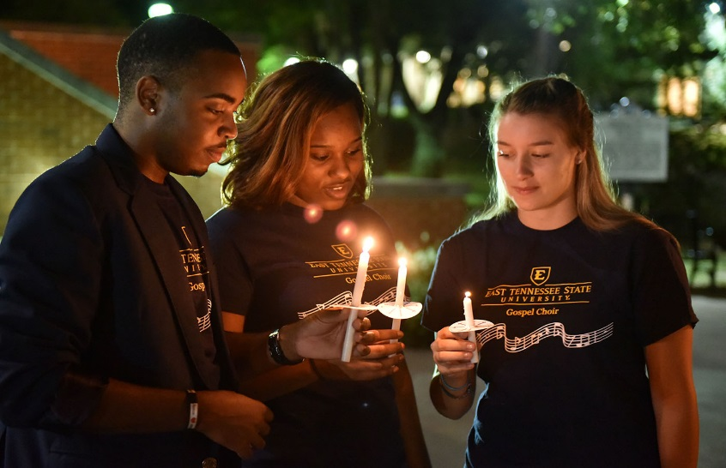
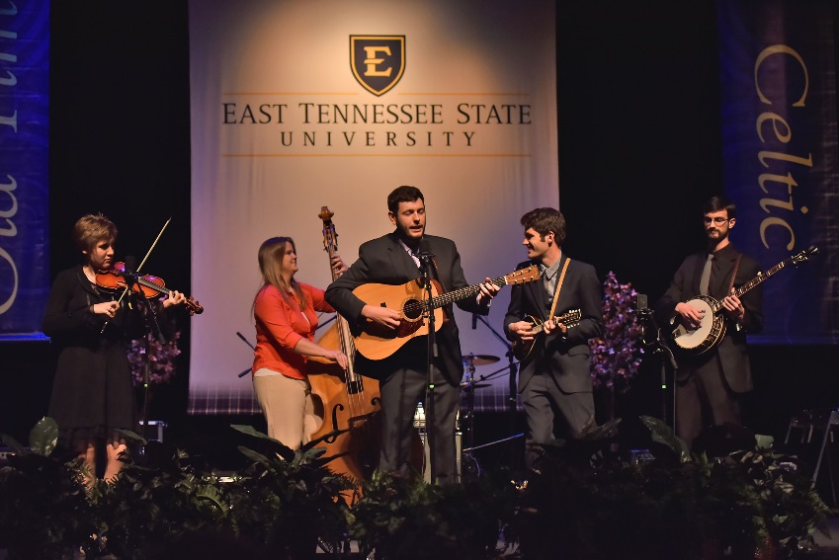
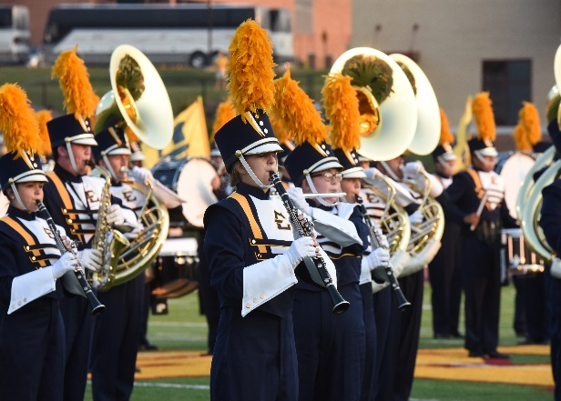

President’s Report
East Tennessee State University
Board of Trustees Spring Quarterly Meeting
March 24, 2017

Slide 2
Budget Principles
Enhancing faculty/staff salaries is ETSU’s overarching budget priority
The establishment of strategic/innovation resource pools is critical to ensure flexibility and responsiveness to changing market forces
The value of “student success” will undergird all budget decisions
Budget increases/decreases will be implemented strategically based upon the evaluation and analysis of data, which will inform decision making
Where feasible, changes in priorities within a unit will be first supported through the substitution/reallocation of unit resources, thereby minimizing the demand for additional University resources
Units will be responsible for the management of fiscal resources within the limits of their specified allocations
In the event that ETSU must implement budget reductions, all units will submit a two percent reduction strategy to their respective vice presidents as part of the unit level budget review

Slide 3
Campus Budget Process
ETSU has implemented a consultative process for developing budget
recommendations to the Board of Trustees. This process:
  aligns budgets and resources with the University’s strategic plan, mission, vision and goals
  provides a multi-year financial plan that will be reviewed and updated regularly
  reflects differences and varying needs across the diverse units of the institution
  promotes fiscal responsibility
  engages and involves the entire ETSU community
  promotes collaboration among academic and administrative units
  allows for the public presentation of budget priorities
  promotes transparency and shared governance
  provides a venue to evaluate and prioritize budget proposals from across the University for which there are limited resources

Slide 4
Strategic Budget Process
Phase 1: The President establishes the strategic priorities, forecasts projected revenues, and issues budget directives to the VPs.
Phase 2: Units prepare prioritized budget proposals for submission to their respective VP. This will include any requests for specialized or required fees and the proposed use of such fees.
Phase 3: The VPs submit their prioritized budget proposals to the Budget Advisory Committee (BAC) for review. The BAC will conduct budget hearings, using the information gleaned from these hearings to prepare the BAC’s budget recommendation.
Phase 4: The President’s senior leadership team will review the BAC’s recommendation and prepare a prioritized recommendation for review by the Interim University Council.
Phase 5: The President will submit the final budget to the Board of Trustees for approval.

Slide 5
Campus Construction Update
Martin Center for the Arts
Football Stadium
D.P Culp University Center Renovation
Inter-professional Education Center
Data Center
Lamb Hall Renovation/Addition

Slide 6
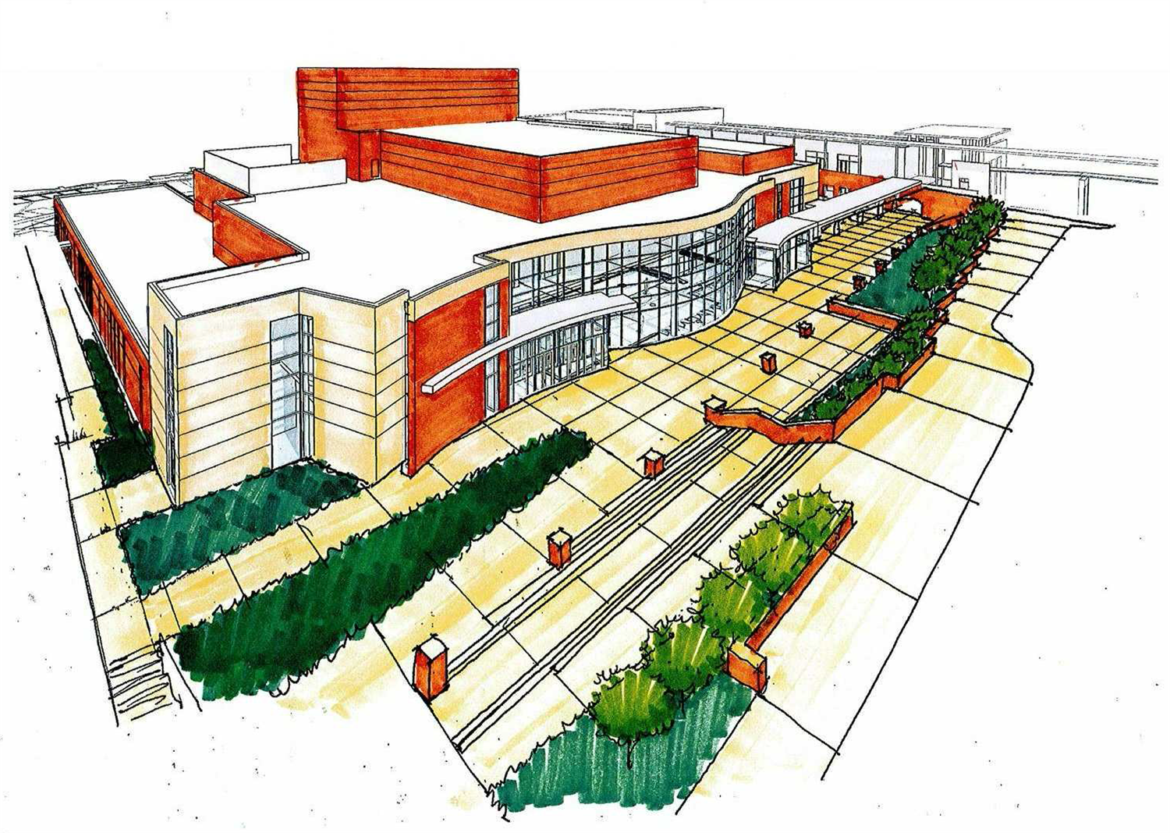
Martin Center for the Arts
Cost: $52.3 million
Projected completion: Spring 2019
Located across from the main campus adjacent to the Centre at Millennium Park, the facility will provide a home for many ETSU arts programs and will include teaching and performance spaces as well as instructional and performance areas. Among the performance areas will be a main concert hall offering seating for 1,200 guests. The project is being funded through a state appropriation, private donations and a partnership with the City of Johnson City.

Slide 7
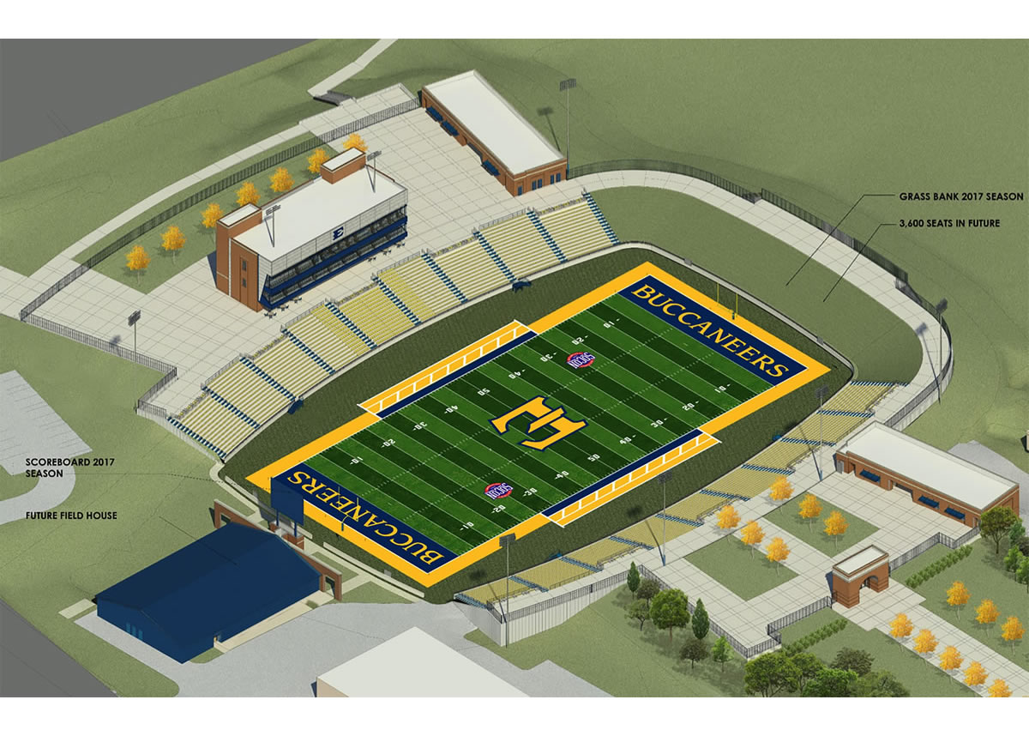
Football Stadium
Cost: $22 million
Projected completion: Summer 2017
Located on the southwest corner of campus, the stadium will include approximately 8,000 seats. Groundbreaking occurred on November 16, 2015. Kenny Chesney and NFL football coach Mike Smith are serving as co-chairs of the fundraising campaign for the stadium. Private donations and student fees are being used to fund the construction of the stadium.

Slide 8
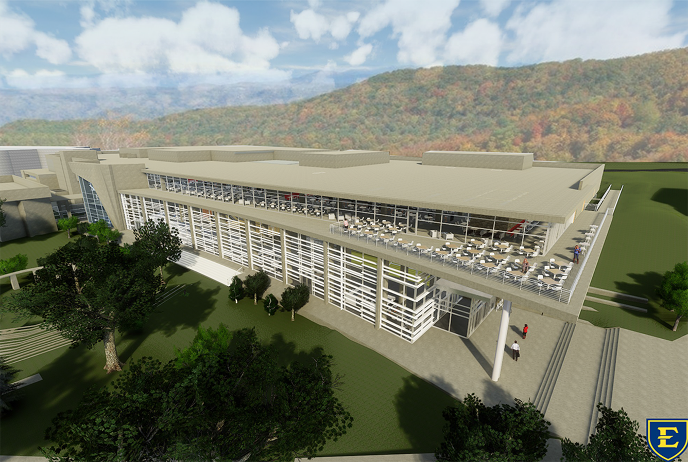
D.P. Culp University Center
Cost: $41 million
Projected completion: 2019
This renovation project, funded through dedicated student fees, will include an expanded and integrated center for student organizations, enhanced student meeting/lounge space, an updated ballroom and meeting rooms, a new 200-person meeting space, and significantly expanded/enhanced dining options.

Slide 9
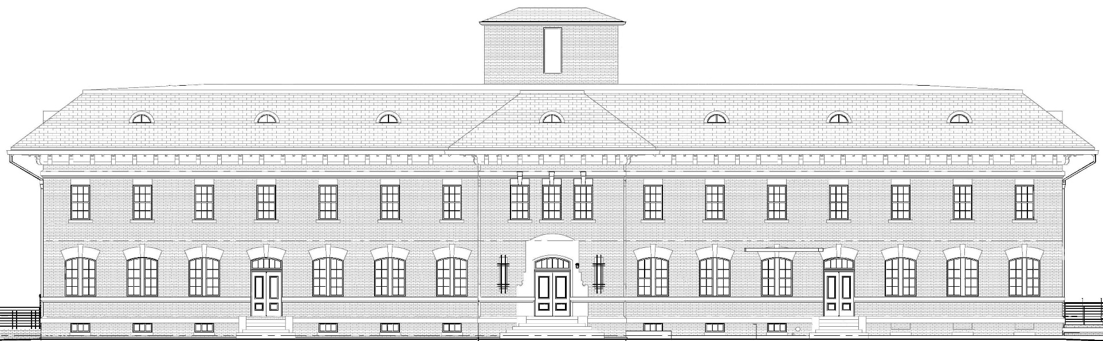
Inter-professional Education Center
Cost: $13 million
Projected completion: Spring 2018
Located adjacent to Stanton-Gerber Hall, this facility will provide state of the art simulation laboratories, research space, classrooms, conference rooms, student study space, food service space, and administrative offices. Faculty, staff, and students from the Gatton College of Pharmacy, Quillen College of Medicine, College of Nursing, College of Public Health, and College of Clinical and Rehabilitative Health Sciences have been actively engaged in the design process.

Slide 10
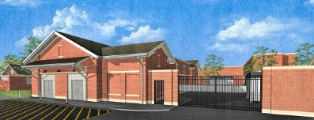
Campus Data Center
Cost: $2.7 million
Projected completion: Spring 2017
The Data Center is a 4,954-square-foot facility being built to house, protect, and service ETSU centralized data and core communications infrastructures. It will be equipped with redundant cooling, conditioned uninterruptible power, fire suppression, and two-factor secure access with capacity for substantial future growth. Construction is on schedule to be completed in December 2016, with migration into the facility over the following months.

Slide 11
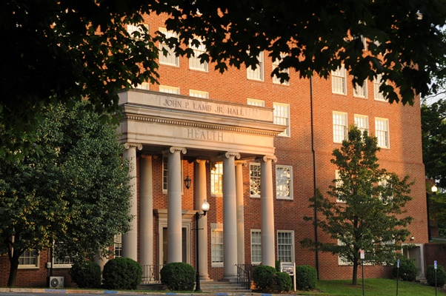
Lamb Hall Renovation
Cost: $21.8 million
Project Completion: Planning funds approved during the 2016 Legislative session; designated number one project on the TBR 2017 capital list; awaiting details of Governor Haslam’s 2017-18 budget
In the near future, ETSU will initiate a major renovation of Lamb Hall, which is the home to many of our health programs. The renovation will provide enhanced teaching and research space for faculty in a variety of academic departments/units.

Slide 12
Legislative Update
Support for the outcomes formula and salary enhancements
Support for capital projects
  Lamb Hall
  Matching requirement
Support for deferred maintenance projects
Opioid research funding
FOCUS implementation
Campus safety
Out of state tuition and DACA students
Recognition of the role of universities in the state policy agenda

