Slide 1
33 Things You Should Know About the Holocaust
Notes:
This template can be used as a starter file for a photo album.

Slide 2
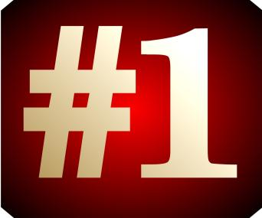
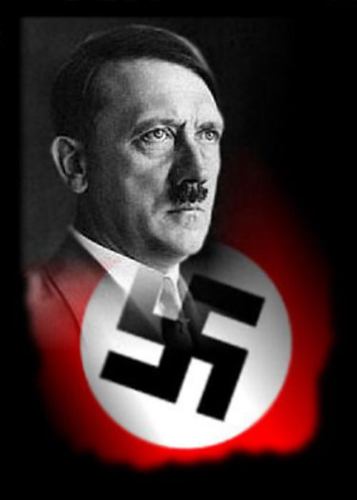
The Holocaust began in 1933 when Adolf Hitler came to power in Germany and ended in 1945 when the Nazis were defeated by the Allied powers.

Slide 3
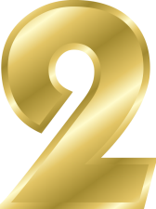
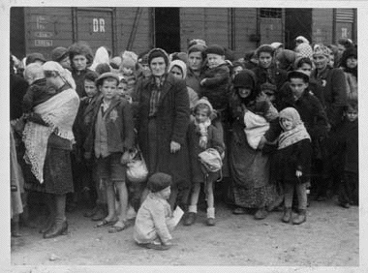
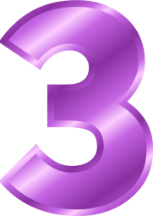
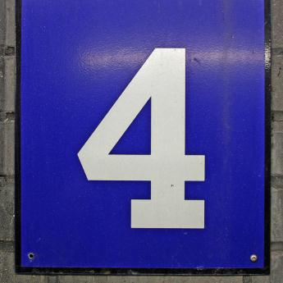
The term "Nazi" is an acronym for "Nationalsozialistishe Deutsche Arbeiterpartei" ("National Socialist German Worker's Party").
The term "Holocaust," originally from the Greek word "holokauston" which means "sacrifice by fire," refers to the Nazi's persecution and planned slaughter of the Jewish people. The Hebrew word "Shoah," which means "devastation, ruin, or waste," is also used for this genocide.
In addition to Jews, the Nazis targeted Gypsies, homosexuals, Jehovah's Witnesses, and the disabled for persecution. Anyone who resisted the Nazis was sent to forced labor camps or murdered.

Slide 4
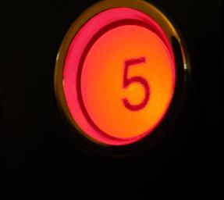
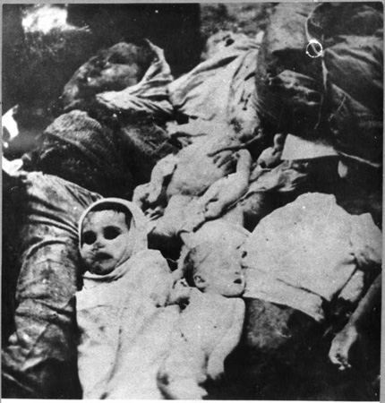
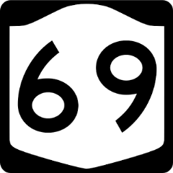
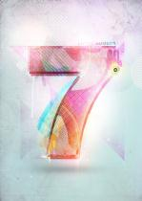
The Nazis used the term "the Final Solution" to refer to their plan to murder the Jewish people.
It is estimated that 11 million people were killed during the Holocaust. Six million of these were Jews.
The Nazis killed approximately two-thirds of all Jews living in Europe.
8
An estimated 1.1 million children were murdered in the Holocaust.

Slide 5

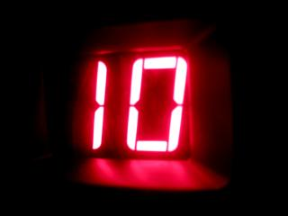
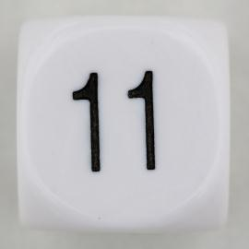
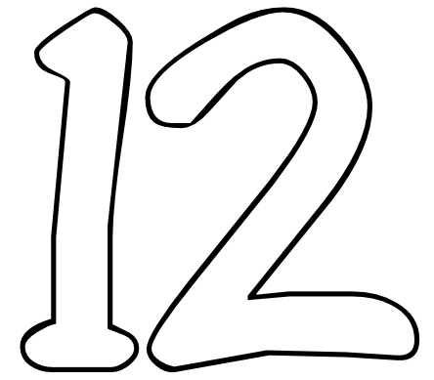
On April 1, 1933, the Nazis instigated their first action against German Jews by announcing a boycott of all Jewish-run businesses.
The Nuremberg Laws, issued on September 15, 1935, began to exclude Jews from public life. The Nuremberg Laws included a law that stripped German Jews of their citizenship and a law that prohibited marriages and extramarital sex between Jews and Germans. The Nuremberg Laws set the legal precedent for further anti-Jewish legislation.
Nazis then issued additional anti-Jews laws over the next several years. For example, some of these laws excluded Jews from places like parks, fired them from civil service jobs (i.e. government jobs), made Jews register their property, and prevented Jewish doctors from working on anyone other than Jewish patients.
During the night of November 9-10, 1938, Nazis incited a pogrom against Jews in Austria and Germany in what has been termed, "Kristallnacht" ("Night of Broken Glass"). This night of violence included the pillaging and burning of synagogues, breaking the windows of Jewish-owned businesses, the looting of these stores, and many Jews were physically attacked. Also, approximately 30,000 Jews were arrested and sent to concentration camps.

Slide 6
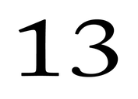
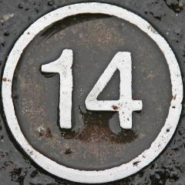
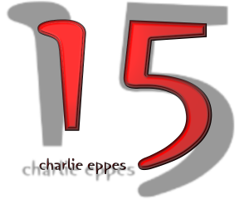
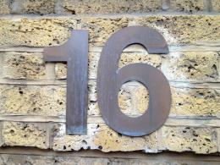
After World War II started in 1939, the Nazis began ordering Jews to wear a yellow Star of David on their clothing so that Jews could be easily recognized and targeted.
After the beginning of World War II, Nazis began ordering all Jews to live within certain, very specific, areas of big cities, called ghettos.
Jews were forced out of their homes and moved into smaller apartments, often shared with other families.
Some ghettos started out as "open," which meant that Jews could leave the area during the daytime but often had to be back within the ghetto by a curfew. Later, all ghettos became "closed," which meant that Jews were trapped within the confines of the ghetto and not allowed to leave.

Slide 7
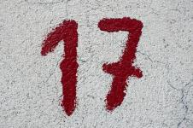
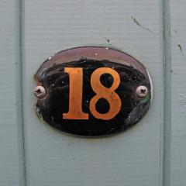
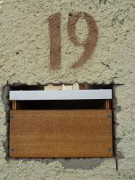
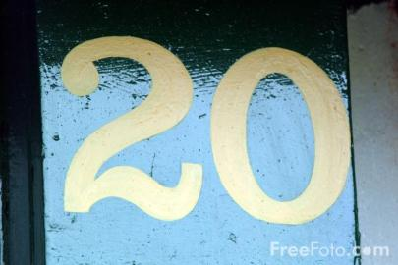
A few of the major ghettos were located in the cities of Bialystok, Kovno, Lodz, Minsk, Riga, Vilna, and Warsaw.
The largest ghetto was in Warsaw, with its highest population reaching 445,000 in March 1941.
In most ghettos, Nazis ordered the Jews to establish a Judenrat (a Jewish council) to both administer Nazi demands and to regulate the internal life of the ghetto.
Nazis would then order deportations from the ghettos. In some of the large ghettos, 1,000 people per day were loaded up in trains and sent to either a concentration camp or a death camp.

Slide 8
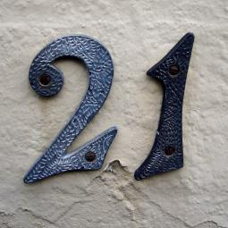
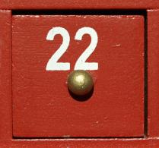
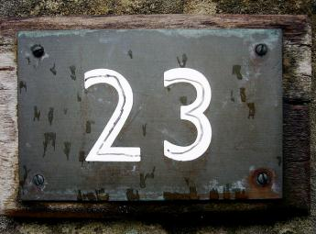
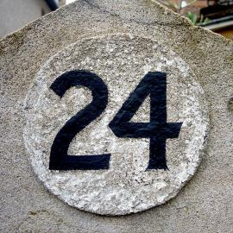
To get them to cooperate, the Nazis told the Jews they were being transported to another place for labor.
When the Nazis decided to kill the remaining Jews in a ghetto, they would "liquidate" a ghetto by boarding the last Jews in the ghetto on trains.
When the Nazis attempted to liquidate the Warsaw Ghetto on April 13, 1943, the remaining Jews fought back in what has become known as the Warsaw Ghetto Uprising. The Jewish resistance fighters held out against the entire Nazi regime for 28 days -- longer than many European countries had been able to withstand Nazi conquest.
Although many people refer to all Nazi camps as "concentration camps," there were actually a number of different kinds of camps, including concentration camps, extermination camps, labor camps, prisoner-of-war camps, and transit camps.

Slide 9
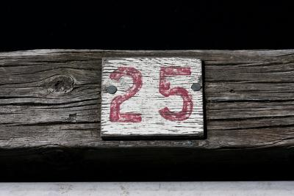
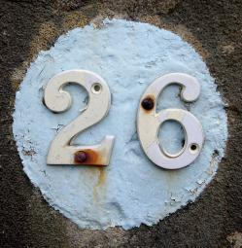
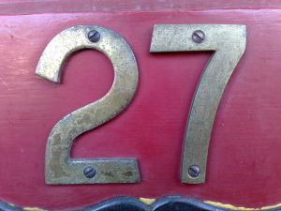
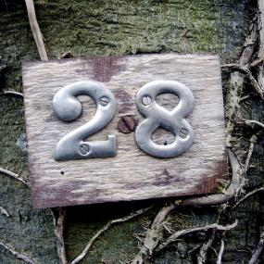
One of the first concentration camps was Dachau, which opened on March 20, 1933.
From 1933 until 1938, most of the prisoners in the concentration camps were political prisoners (i.e. people who spoke or acted in some way against Hitler or the Nazis) and people the Nazis labeled as "asocial."
After Kristallnacht in 1938, the persecution of Jews became more organized. This led to the exponential increase in the number of Jews sent to concentration camps.
Life within Nazi concentration camps was horrible. Prisoners were forced to do hard physical labor and yet given tiny rations. Prisoners slept three or more people per crowded wooden bunk (no mattress or pillow). Torture within the concentration camps was common and deaths were frequent.

Slide 10
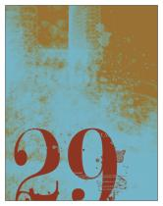
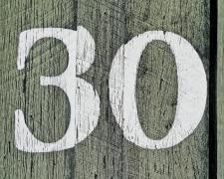
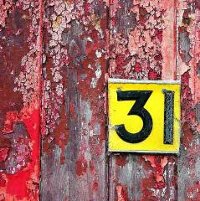
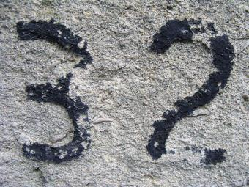
At a number of Nazi concentration camps, Nazi doctors conducted medical experiments on prisoners against their will.
While concentration camps were meant to work and starve prisoners to death, extermination camps (also known as death camps) were built for the sole purpose of killing large groups of people quickly and efficiently.
The Nazis built six extermination camps: Chelmno, Belzec, Sobibor, Treblinka, Auschwitz, and Majdanek. (Auschwitz and Majdanek were both concentration and extermination camps.)
Prisoners transported to these extermination camps were told to undress to take a shower. Rather than a shower, the prisoners were herded into gas chambers and killed. (At Chelmno, the prisoners were herded into gas vans instead of gas chambers.)

Slide 11
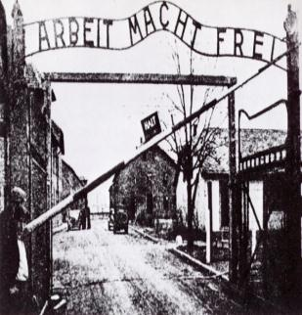
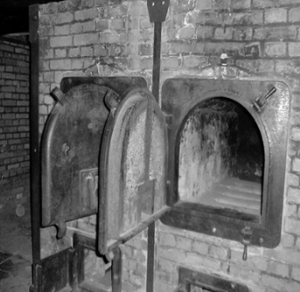
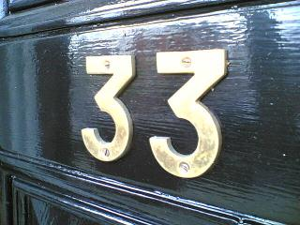
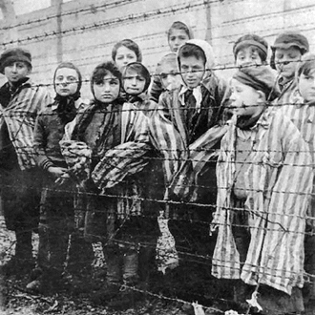
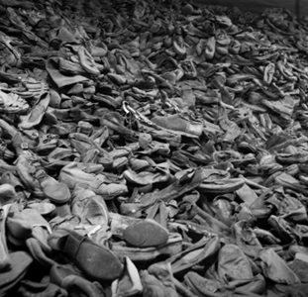
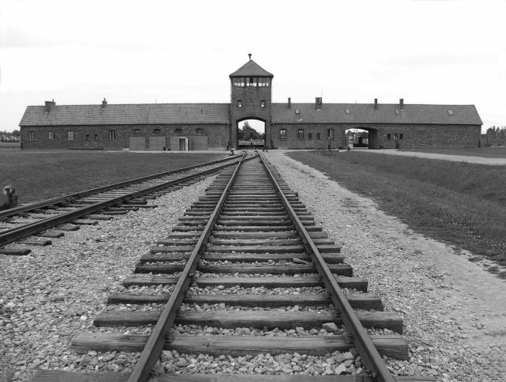
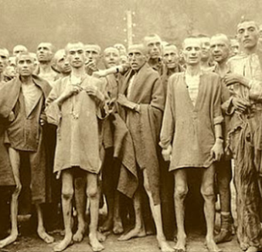
Auschwitz was the largest concentration and extermination camp built.
It is estimated that over 1.1 million people were killed at Auschwitz.

