Slide 1
Elements of Horror
Setting

Slide 2
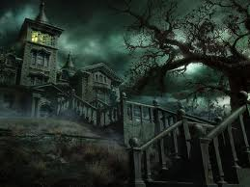

a deserted (or sparsely inhabited) castle or mansion in a state of ruins or semi-ruins
labyrinths/mazes, dark corridors, and winding stairs filled with dusty cobwebs
castles or mansions which have hidden tunnels/staircases, dungeons, underground passages, crypts, or catacombs
if set in a broken down modern house, the basement or attic becomes the place of terror
threatening natural landscapes, like rugged mountains, dark forests, or eerie moors, exhibiting stormy weather

Slide 3
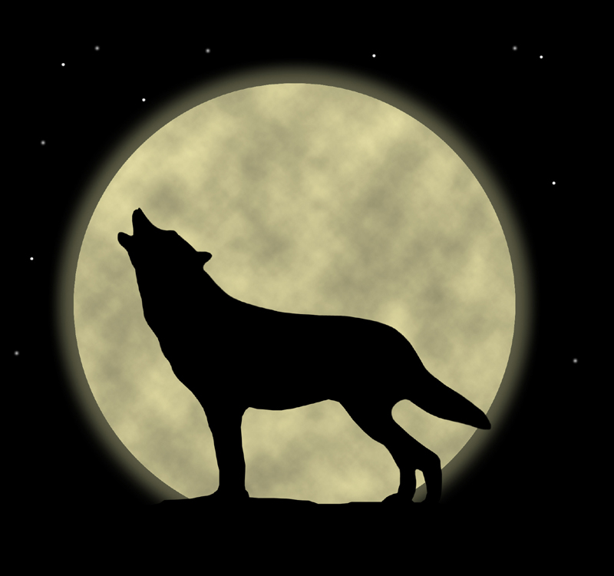

Elements of Horror
Lighting/Mood

Slide 4
Blackout
limited lighting such as moonlight (usually a full moon), candles, flashlight, lantern
often the light disappears: clouds hide the moon, candles go out, flashlights/ lanterns are dropped and broken
if electric lights exist, they usually mysteriously go out

Slide 5
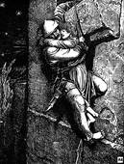
Other Elements
dark secrets surrounding some tormented soul who is left to live in isolation
ominous omens and curses
magic, supernatural manifestations, or the suggestion of the supernatural
a damsel in distress
the damsel’s rescuer; usually a lover
horrifying (or terrifying) events or the threat of such happenings

Slide 6
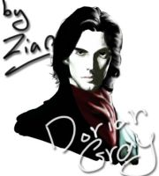
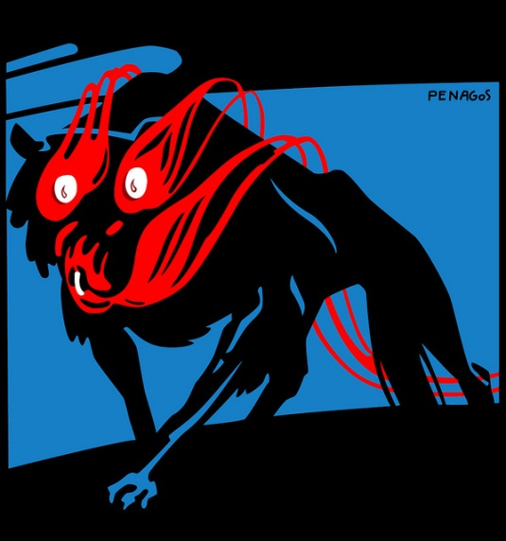
Victorian Horror Novels
Classics of the horror genre written during the Victorian Era:
Frankenstein
Dracula
The Hound of the Baskervilles
The Hunchback of Notre Dame
The Picture of Dorian Gray
Dr. Jekyll and Mr. Hyde
The Invisible Man

Slide 7
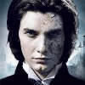
Elements of Classic Horror of the Victorian Age
Psychological terror not physical terror
Not a lot of bloodshed
Suspense, Suspense, Suspense
The object was to let the imagination go wild!!!!

Slide 8

Due Dates
Short Story Map: Friday, October 14, 2016
1st Rough Draft: Wednesday, October 19, 2016
2nd Rough Draft: Wednesday, October 26, 2016
Final Draft: Wednesday, November 9, 2016

