Slide 1
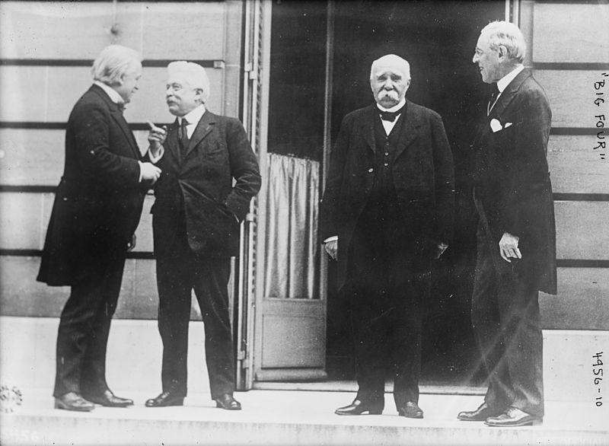
The Big Four
British = David Lloyd George
Italy = Vittorio Orlando
France = Georges Clemenceau
U.S. = Woodrow Wilson

Slide 2
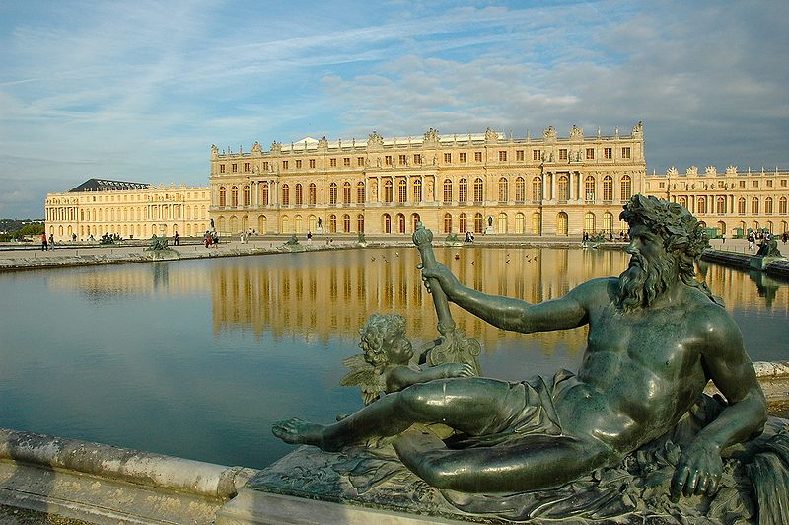
The Big Four
The big four meet at the Paris Peace Conference following WWI
Also known as the Council of Four
Met at Versailles

Slide 3
Treaty of Versailles
Signed on June 28, 1919
Exactly 5 years after the assassination of Archduke Franz Ferdinand
Treaty was between the Allies and Germany
Other Central powers had separate treaties

Slide 4
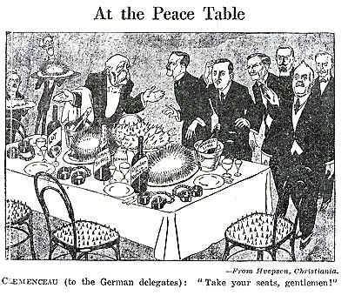
Treaty of Versailles
Germany, other Central Powers not invited to negotiate
Russia not invited
  It had negotiated a separate peace with Germany in 1918.

Slide 5
Paris Peace Conference
French wanted to weaken Germany as much as possible.
  Why?
Buffer state between Germany and France
Reparations
  What are reparations?

Slide 6
Paris Peace Conference
British also wanted reparations
French and British are concerned about national security
  What is national security?

Slide 7
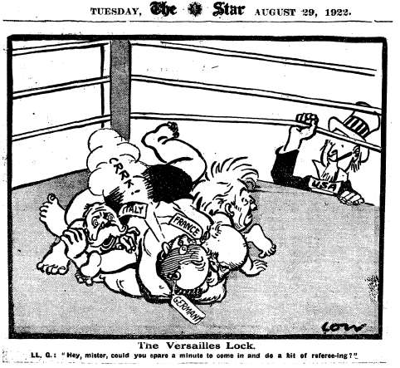
Paris Peace Conference
U.S. (Wilson) wanted to implement the 14 point plan
Self-determination
League of Nations

Slide 8
Treaty of Versailles
Required Germany to accept responsibility for causing the war
  Known as the War Guilt clause
Germany had to hand over 70,000 kilometers (43,000 miles) of land to the Allies
  Wanted to make Germany weaker and other European countries stronger

Slide 9
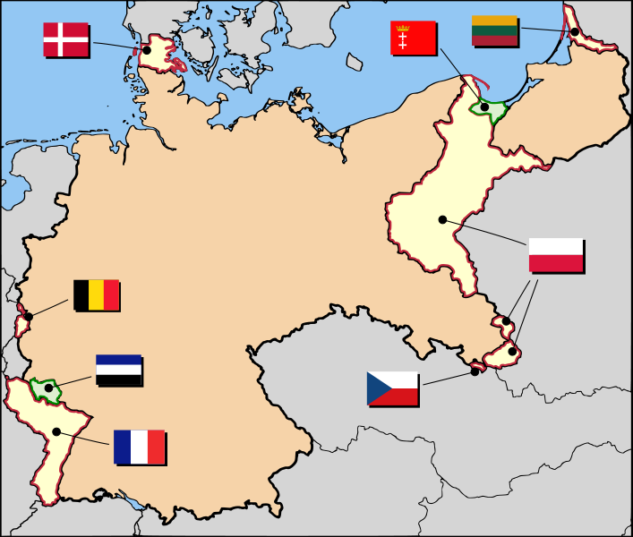

Slide 10
Treaty of Versailles
Germany had to pay 31.4 billion dollars to the Allies ($442 billion in 2013)
  Reparations for damage done during the war
Had to hand over all of its colonies to the Allies

Slide 11
Treaty of Versailles
German army reduced to 100k soldiers
  No draft allowed
Navy reduced to 15k men and 6 battleships
Not allowed an Air Force or submarines
Importing/exporting of war materials was banned

Slide 12
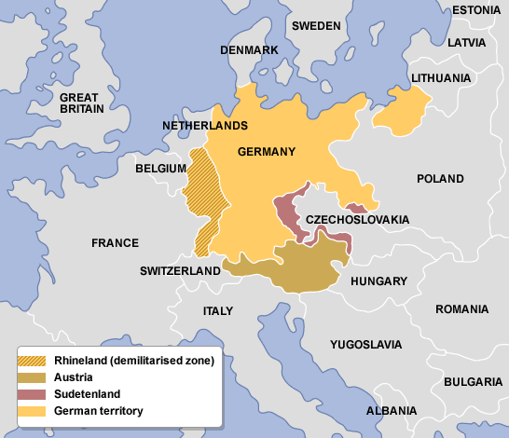
Treaty of Versailles
Rhineland was to be occupied by Allied troops for 15 years
  Area that bordered France
No German troops allowed in the area

Slide 13
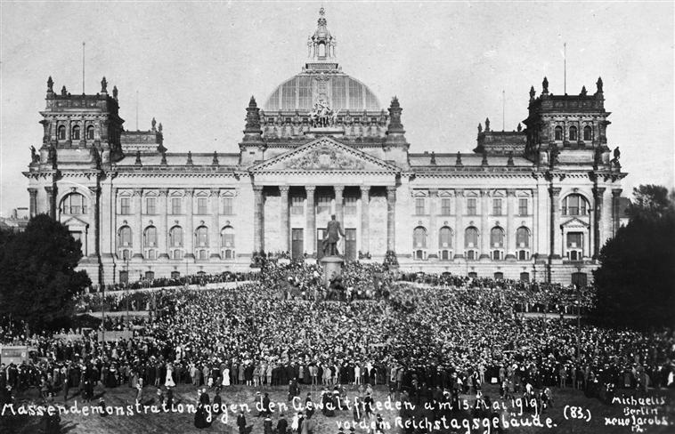
German Reaction
Outraged
Felt betrayed by its leaders
“We know the full brunt of hate that confronts us here. You demand from us to confess we were the only guilty party of war; such a confession in my mouth would be a lie.” - German foreign minister

Slide 14
German Reaction
Felt honor was violated
  Were not allowed to negotiate
Felt “stabbed in the back” by government, others who were unpatriotic

Slide 15
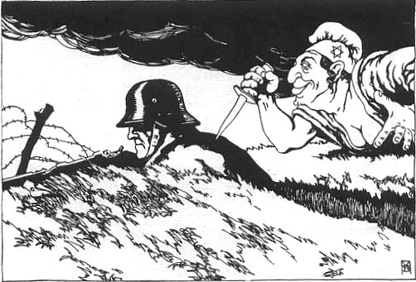

Slide 16
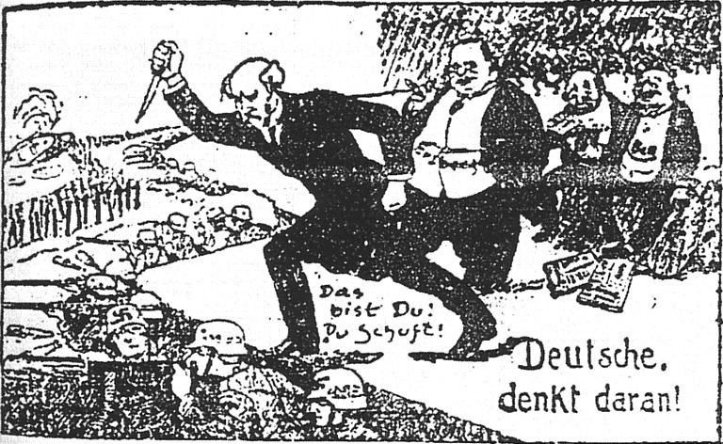

Slide 17
Treaty of Versailles
440 clauses in final treaty
First 26 = establishment of League of Nations
Final 414 = dealt with German punishment

Slide 18
Test Tuesday!
Homework: Skillbuilder map on page 860.
Answer both questions at the bottom of the map!

