Slide 1
Causes of WWI
Militarism – The policy of glorifying military power and keeping an army prepared for war.
Alliances – Unions or associations formed for mutual benefit.
Imperialism – When a country increases their power and wealth by bringing additional territories under their control.
Nationalism – Love or loyalty to one’s nation

Slide 2
Causes of WWI
Assassination of Franz Ferdinand.
Archduke of Austria-Hungary.
Killed by Serbian terrorist group called the Black Hand.
Led to Austria-Hungary declaring war on Serbia.

Slide 3
Alliances
Central Powers
Germany
Austria-Hungary
Bulgaria
Ottoman Empire
Allies
Great Britain
France
Russia
Italy
Serbia

Slide 4
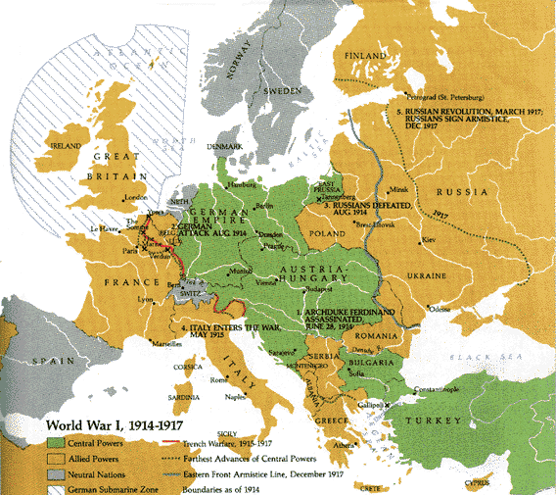

Slide 5
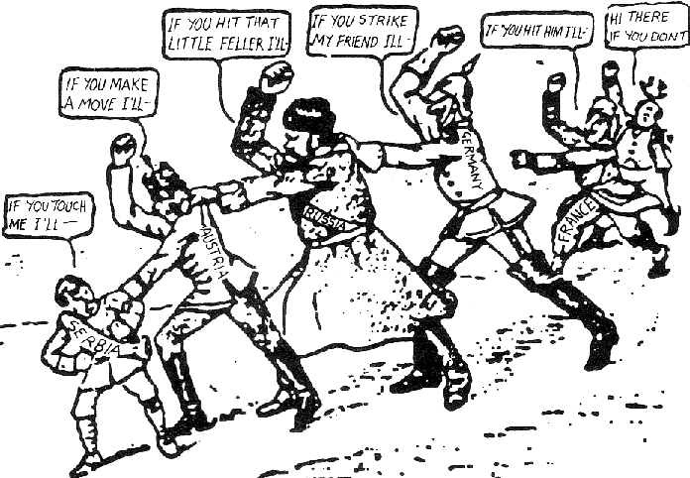

Slide 6
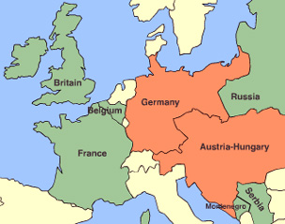
Western Front
Northern France
War = Stalemate
Introduction of Trench Warfare

Slide 7
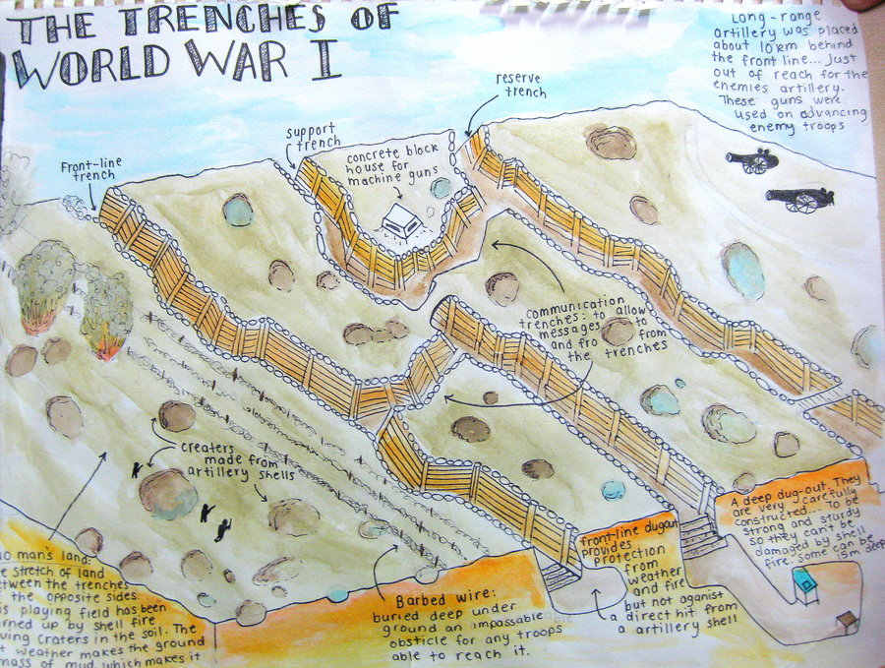

Slide 8
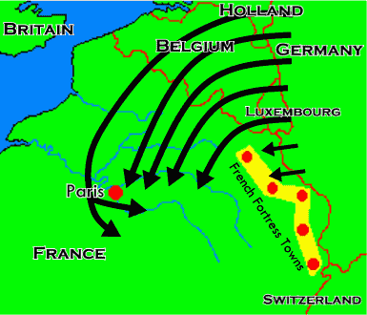
Schlieffen Plan
General Alfred Graf Von Schlieffen
Facing war on 2 fronts
Attack and defeat France in the Western Front then rush east and fight Russia on the Eastern Front

Slide 9

Eastern Front
Russia and Serbia vs Germany and Austria-Hungary
Fighting on German/Russian border
Russia = not yet industrialized
Made up for it in numbers

Slide 10


