Slide 1
Review Questions
1) List at least 2 reasons the U.S. got involved in WWI
2) How did the United States feel about being involved in WWI at the beginning?
3) What did Germany offer Mexico if they helped out in the war?

Slide 2
U.S. now involved
Wilson won re-election in 1916 under the slogan: “He kept us out of war.”
“Peace without victory” speech

Slide 3
U.S. now involved
“The world must be made safe for democracy”
Wilson asks Congress for declaration of war

Slide 4
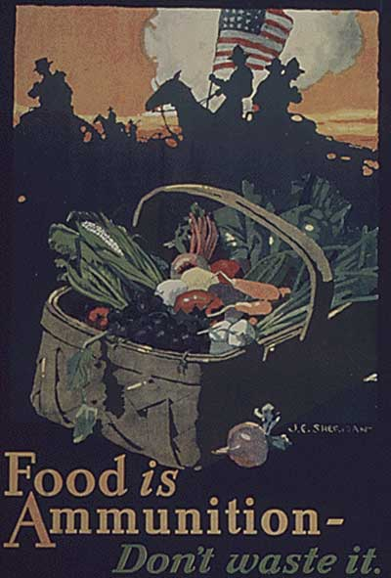
U.S. Mobilization
War Industries Board coordinated production and price controls
Food Administration (Herbert Hoover) voluntary efforts to conserve food for soldiers
Financing - Liberty Bonds

Slide 5
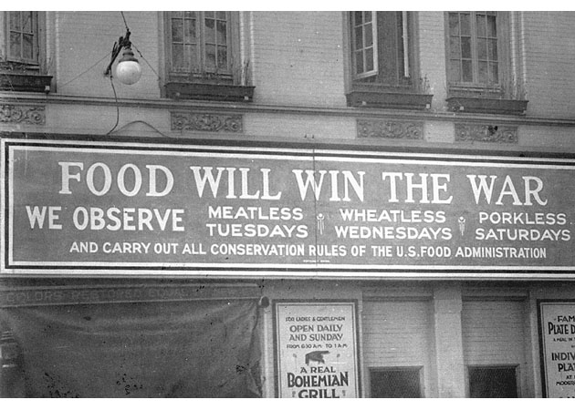

Slide 6
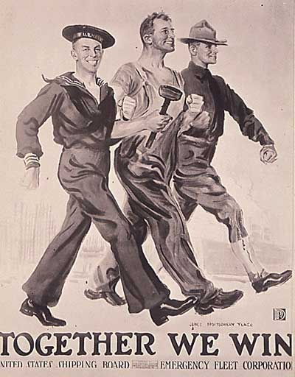
U.S. Mobilization
Committee on Public Information - propaganda agency in America “do your bit” for the war
Hate the Hun, Liberty Cabbage, Can the Kaiser

Slide 7
Maintaining Support for the War
Espionage and Sedition Acts (1917-18) jail sentences for those critical of disloyal or abusive remarks toward US war effort
Schenck v. United States (1919) “clear and present danger” - free speech could be limited

Slide 8
Was it really a “World” War?
Fighting in African/Asian colonies
Japan takes Germany’s Pacific colonies
India sends troops to help British
Map p. 852

Slide 9
Selective Service
Selective Service Act (1917) draft: 2.8 million draftees, 2.9 million volunteers
Eventually 2 million were sent to Europe

Slide 10
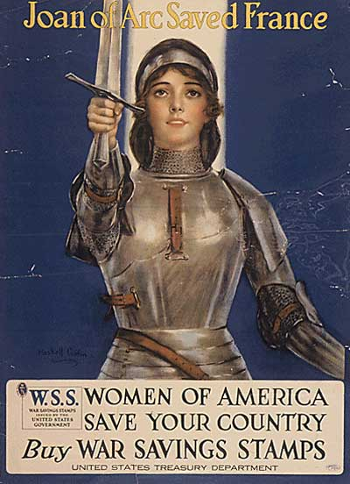
Total War
Nations devote all resources to war effort
  Factories
  Rationing
  Women do jobs left behind by men

Slide 11
Russia Withdraws
Shortages on fuel/food cause civil unrest
Too many soldiers have died
Army refuses to fight any longer

Slide 12
Russia Withdraws
Czar Nicholas II steps down
Vladimir Lenin comes to power
  Offers Germany a truce

Slide 13
Russia Withdraws
War between Russian/Germany officially over
  Eastern Front is no longer a warzone
By 1917 – 5.5 mil Russian soldiers wounded, killed, or taken prisoner

Slide 14
Germany Focuses on Western Front
Sends most forces to Western Front
Near Paris, nearing victory
U.S. sends 140k fresh troops, counter attack

Slide 15
Germany Focuses on Western Front
Battle of Marne (Marne River)
2nd battle at Marne, more than 2 mil U.S. troops

Slide 16
Allies push Germany back
Advance towards Germany
Central Powers begin to crumble

Slide 17
Allies begin to Crumble
Bulgaria/Turks surrender
Austria-Hungary = revolution
German soldiers mutinied, public turns on Kaiser

Slide 18
Kaiser Wilhelm steps down
New German govt meets w/ France
Signs armistice with France
  Officially ends WWII
Fighting stops at 11 on 11/11
  But some didn’t know and kept fighting

Slide 19
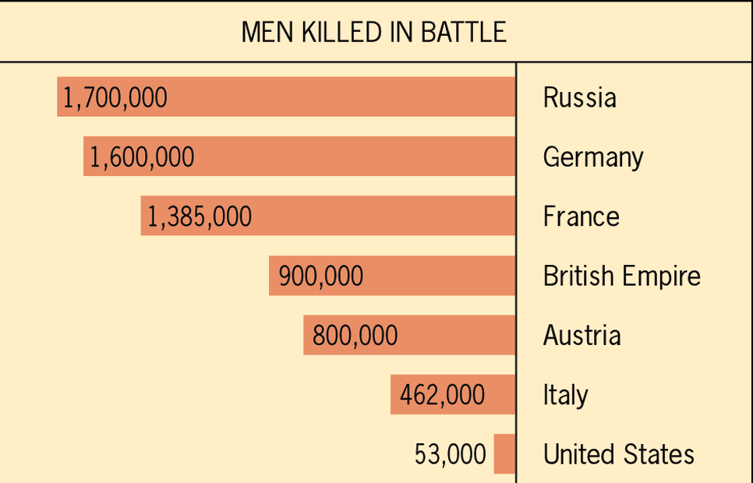
The Cost of War
8.5 mil deaths
21 mil wounded
Cost of War = 338 billion dollars

Slide 20
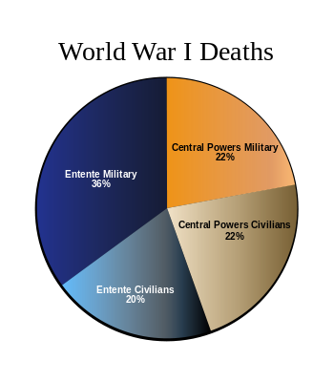
Deaths

Slide 21
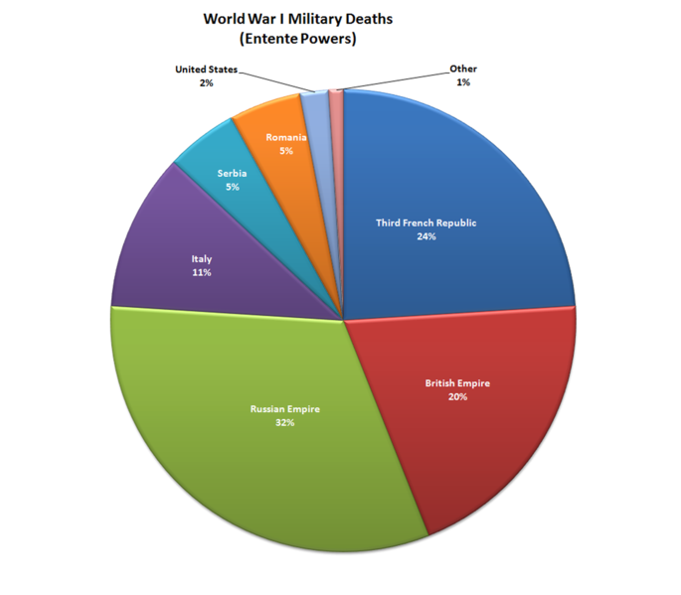
Military Deaths

