Slide 1
Review Questions
1) What caused fighting to stop on the Eastern Front?
2) Which event officially ended WWI?
3) What was the day and time when fighting stopped?

Slide 2
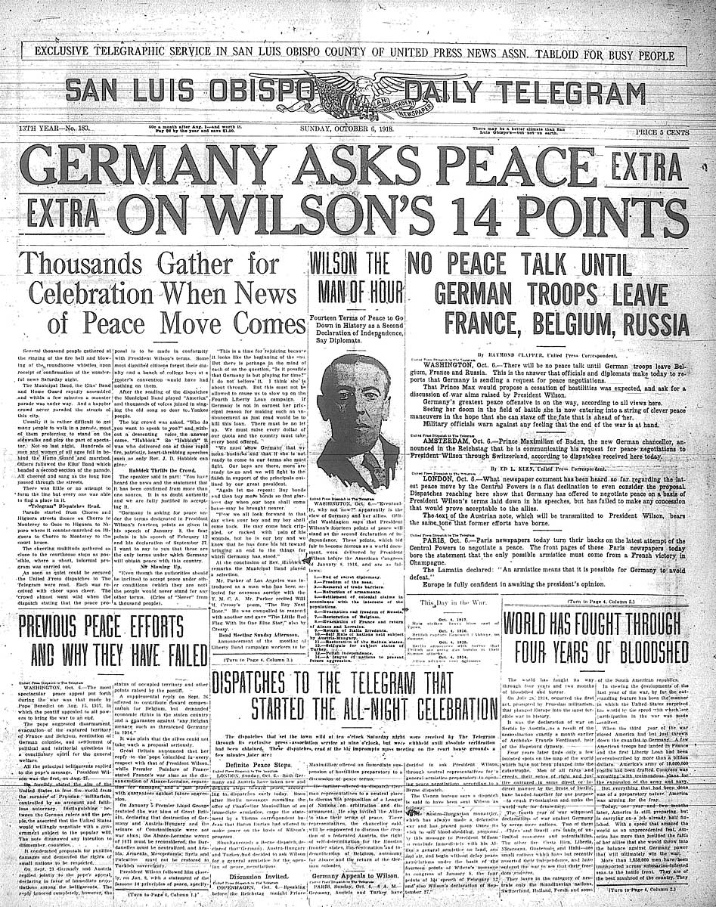

Slide 3
Wilson’s 14 Point Plan
While still at war, Woodrow Wilson draws up a series of peace proposals.
Drawn up 10 months before the war ended
These are known as his 14 Points

Slide 4
14 Points
Points 1-4 include:
An end to secret treaties
Freedom of the seas
Free trade
Reduced national armies and navies

Slide 5
14 Points
Point 5 was the adjustment of colonial claims with fairness toward colonial peoples
What does this mean?

Slide 6
14 Points
Points 6-13 were specific suggestions for changing borders and creating new nations.
The guiding idea behind these points was Self-determination

Slide 7
14 Points
Self-Determination = allowing people to decide for themselves under what government they wished to live

Slide 8
14 Points
Point 14 proposed a “general association of nations”
These nations would protect “great and small states alike”
Wilson wanted an organization that could peacefully negotiate solutions to world conflicts.

Slide 9
14 Points were accused of being Allied propaganda
Copies were dropped behind German lines to encourage surrender. Why?
Became the basis of German surrender

Slide 10
Woodrow Wilson
Wilson awarded 1919 Nobel Peace Price for his peacemaking efforts
Were his points a success?
They provide a framework for the discussions at Versailles

