Slide 1
The Rise of Industrialization
Westward Expansion

Slide 2
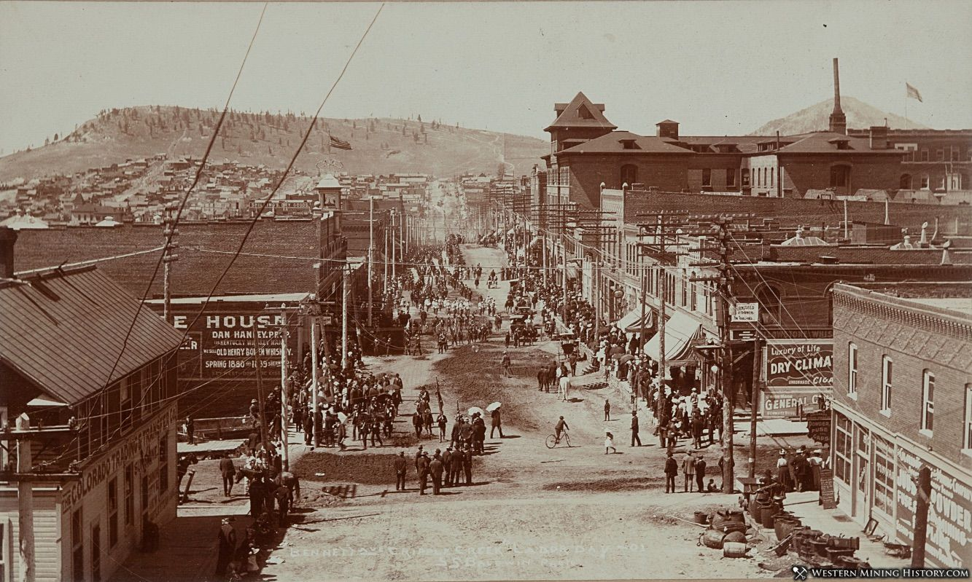
Miners Hope to Strike Rich
Mining was first great boom in the west
Gold and silver attracted people from around the world

Slide 3
Miners Hope to Strike Rich
When gold was discovered, people began to pour into the area
Area usually ill-prepared for their arrival
Mining camps spring up to house miners
Others saw opportunity to make fortunes by selling supplies to miners

Slide 4
Miners Hope to Strike Rich
As towns grow, marshals and sheriffs hired to keep the peace
Many mining towns were “boomtowns”- thrived only as long as the gold supply held out
Many boomtowns became abandoned when the precious metals disappeared

Slide 5
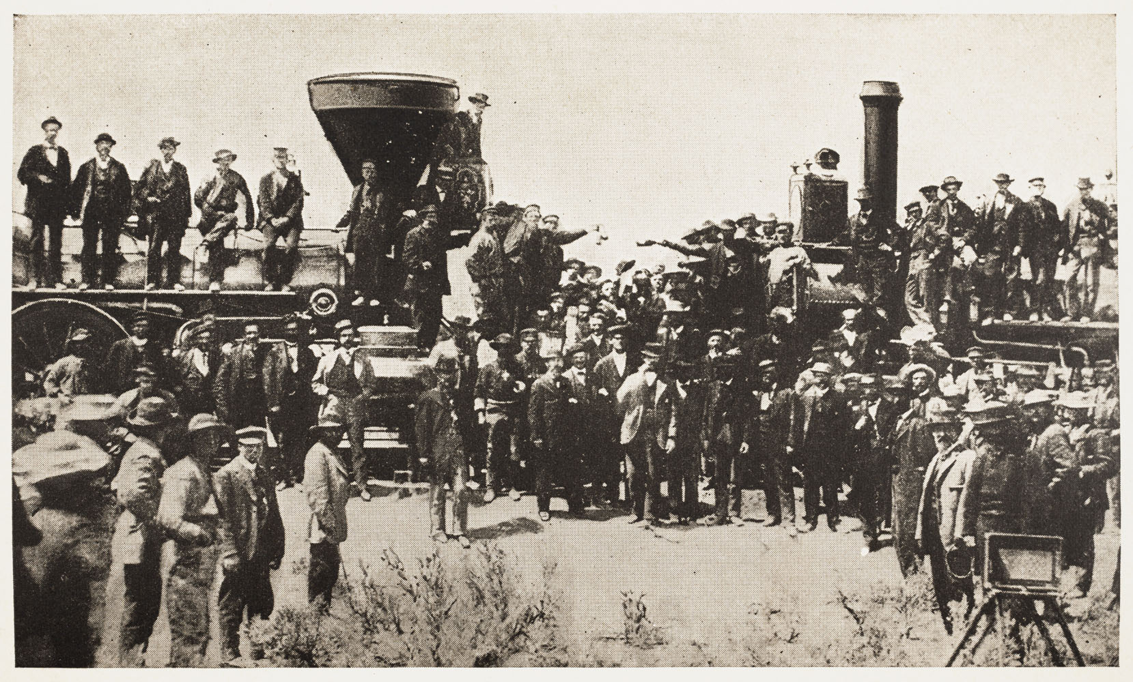
The Transcontinental Railroad
As industry in West grew, need of transport grew
Arguments over placement of railroad delayed construction of a transcontinental railroad

Slide 6
The Transcontinental Railroad
Unlike Europe, US expected railroads to be built by private enterprise
Two ways Congress supported railroad construction:
Provided money in the form of loans
Made land grants- gave builders wide stretches of land on track route

Slide 7
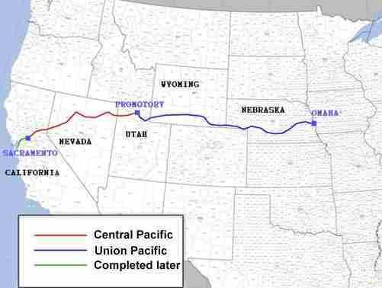
The Transcontinental Railroad
1863:
Central Pacific starts in Sacramento, California laying track east
Union Pacific lays track west from Omaha Nebraska

Slide 8
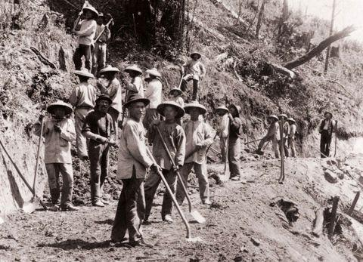
The Transcontinental Railroad
Central Pacific Company brought workers from China to build railroad
Extremely harsh working conditions
Little regard paid to workers safety
Irish immigrants built track for Union Pacific
Tracks met in Promontory, Utah in 1869

Slide 9
Effects of Railroad
Railroad tied the nation together
Moved products and people, spurred industrial development
Stimulated growth of towns and cities along the railroad
Intensified demand for Native American land
Brought tides of people into Mexican American communities of the Southwest

Slide 10
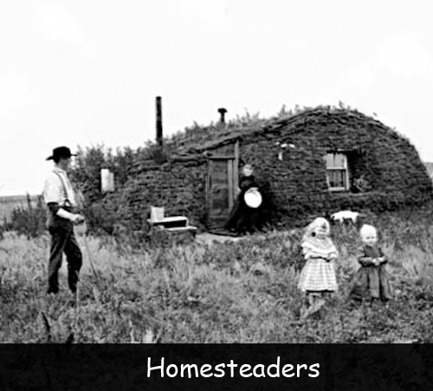
The Homestead Act
Great Plains last area to be heavily settled by white people
Homestead Act 1862- US government offered farm plots of 160 acres to anyone willing to live on the land for five years
Must dig a well and build a road

Slide 11
The Homestead Act
Many settlers were former slaves who fled the South after Reconstruction
Homesteading life was difficult
Windstorms, blizzards, droughts, etc.

