Slide 1
Dictators of WWII:
Hitler and Stalin
World history and geography, w.43: Analyze the assumption of power by Adolf Hitler in Germany and the resulting acts of oppression and aggression of the Nazi regime

Slide 2
Hitler and Fascism/Nazism

Slide 3
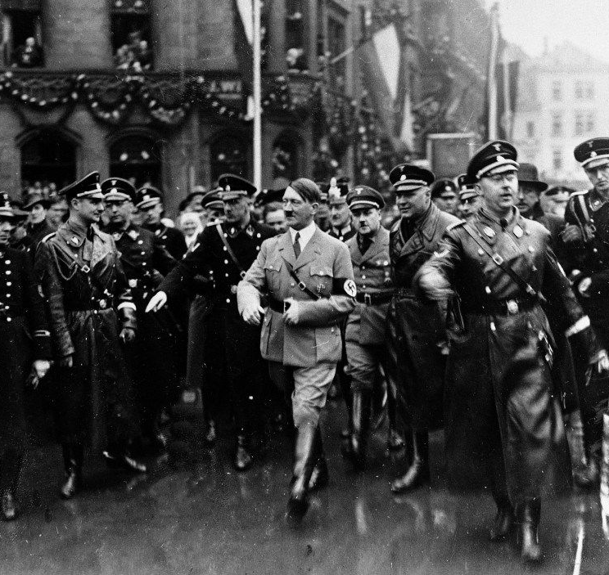
What is Fascism/Nazism?
Fascism
  Fascism is a radical, authoritarian, nationalist political ideology.
  Believes that a nation requires strong leadership and a singular collective identity and forbid opposition to the state.
  Nazism is a form of Fascism.

Slide 4
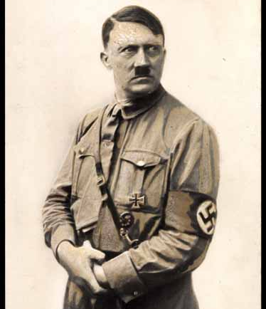
What was Hitler’s form of Fascism like?
  Hitler believed that Germany had been weakened by groups that lived within its borders.
  He called for the purification of the Aryan race (blonde, blue-eyed Germans) by removing groups he considered “undesirable.”

Slide 5
Stalin and Communism/Stalinism

Slide 6
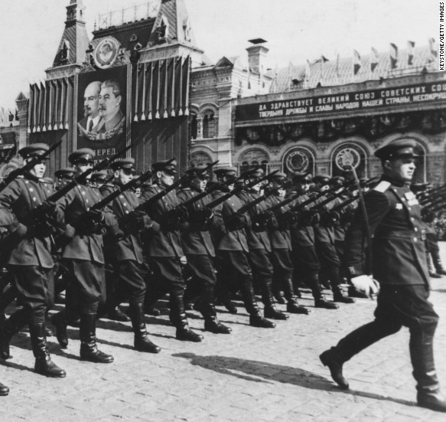
What is Communism/Stalinism?
  A totalitarian system of government (ruled by a dictator with very little or no freedom) where a single party controls state-owned means of production.
  No private property.

Slide 7
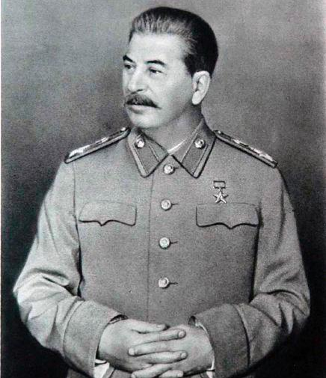
What was Stalin’s form of Communism like?
  Stalinism revers to the policies and governmental philosophy of Joseph Stalin.
  During the Great Terror of the 1930s, Stalin purged the party of “enemies of the people,” which resulted in the execution of thousands and the exile of millions to slave labor camps.

Slide 8
How are Fascism and Communism…
Similar
Different
The militarization created jobs.
Government has unrestrained power.
Fascism allowed private property, but controlled it, while Communism doesn’t allow private property.
Fascism told people they had to sacrifice for their country, Communism told people they had to sacrifice for their fellow citizens.

