Slide 1
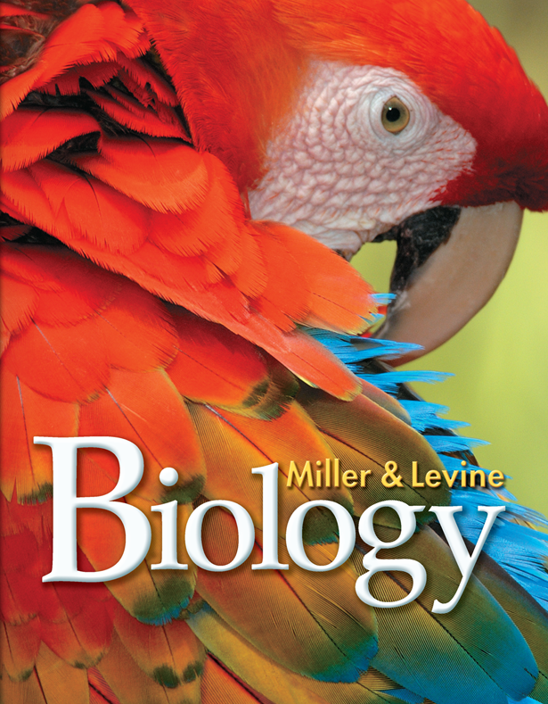
Lesson Overview
7.1 Life is Cellular

Slide 2
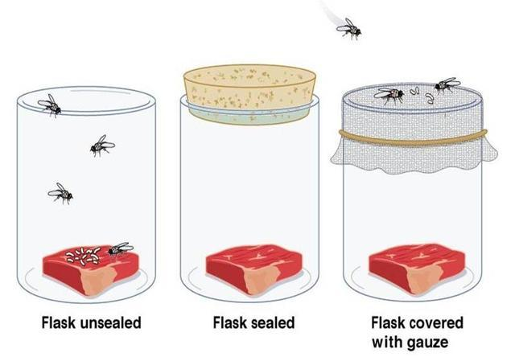
Spontaneous Generation
The supposed production of living organisms from nonliving matter
Francisco Redi (1668) – Proposed flies were responsible for maggots in rotting meat

Slide 3
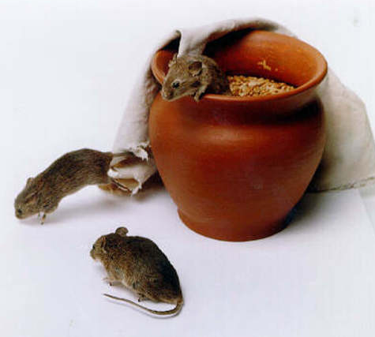
A Recipe For… A Mouse?
"If a soiled shirt is placed in the opening of a vessel containing grains of wheat, the reaction of the leaven in the shirt with fumes from the wheat will, after approximately 21 days, transform the wheat into mice.”
-- Jean Baptiste van Helmont
(early 1600s)

Slide 4
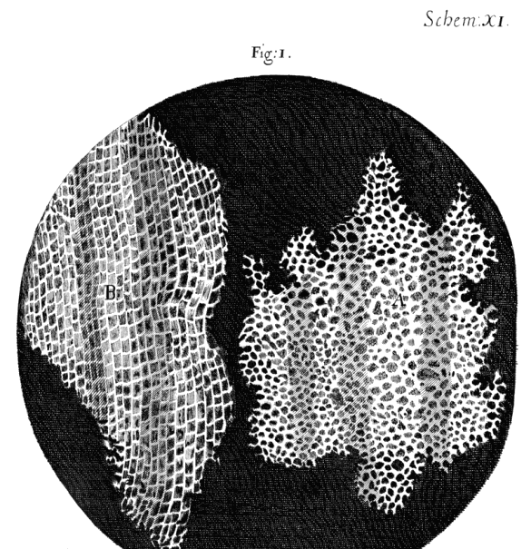
Early Microscopes
  Robert Hooke (1665)
    Used a microscope to look at a slice of cork.
    Cork was made of tiny, empty chambers that Hooke called “cells”.
  Anton van Leeuwenhoek (1673)
    Examined pond water and other things, including a sample taken from a human mouth. He called the tiny organisms he saw “animacules”.

Slide 5
The Cell Theory
  Other scientists’ contributions confirmed that cells were the basic units of life.
  Matthias Schleiden (1838, German botanist)
    Concluded that all plants are made of cells.
  Theodor Schwann (1839, German biologist)
    Stated that all animals were made of cells.
  Rudolf Virchow (1855, German physician)
    Concluded that new cells could be produced only from the division of living cells.

Slide 6
The Cell Theory
  These discoveries are summarized in cell theory.
  Cell theory states:
    All living things are made up of cells.
    Cells are the basic units of structure and function in living things.
    New cells are produced from existing cells.

Slide 7
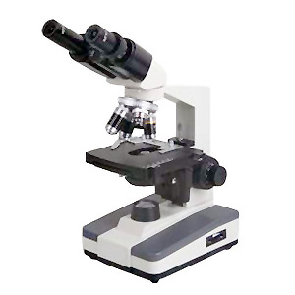
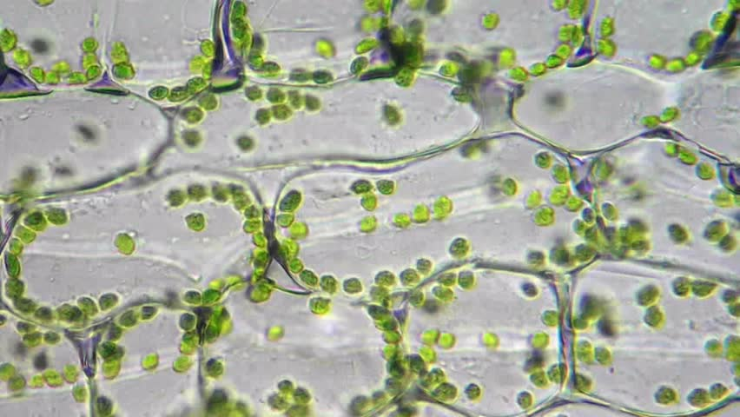
Light Microscopes and Cell Stains
  A light microscope allows light to pass through a specimen and uses two lenses to form an image.
  Light microscopes can produce clear images of objects only to a magnification of about 1000 times.
  Chemical stains are used to view transparent substances.

Slide 8
Electron Microscopes
  Offer much higher resolution.
  Use beams of electrons focused by magnetic fields.
  Electron microscopy can be used to examine only nonliving cells and tissues.
  Two major types of electron microscopes:
      Transmission
      Scanning

Slide 9
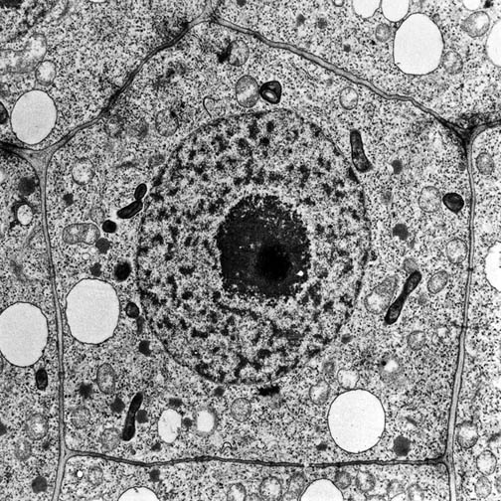
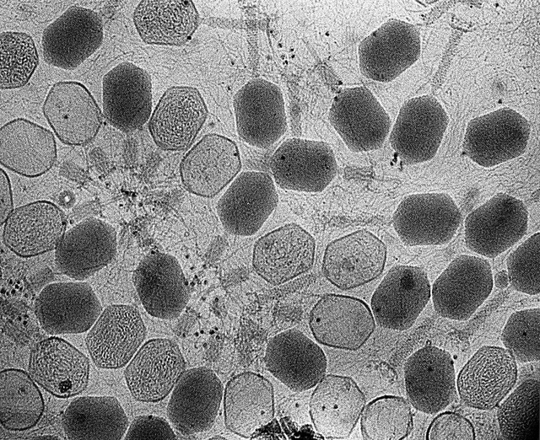
Transmission Electron Microscopes
  Transmission electron microscopes make it possible to explore cell structures and large protein molecules.
  Transmission electron microscopes produce flat, 2D images.
root cell
bacteriophages

Slide 10
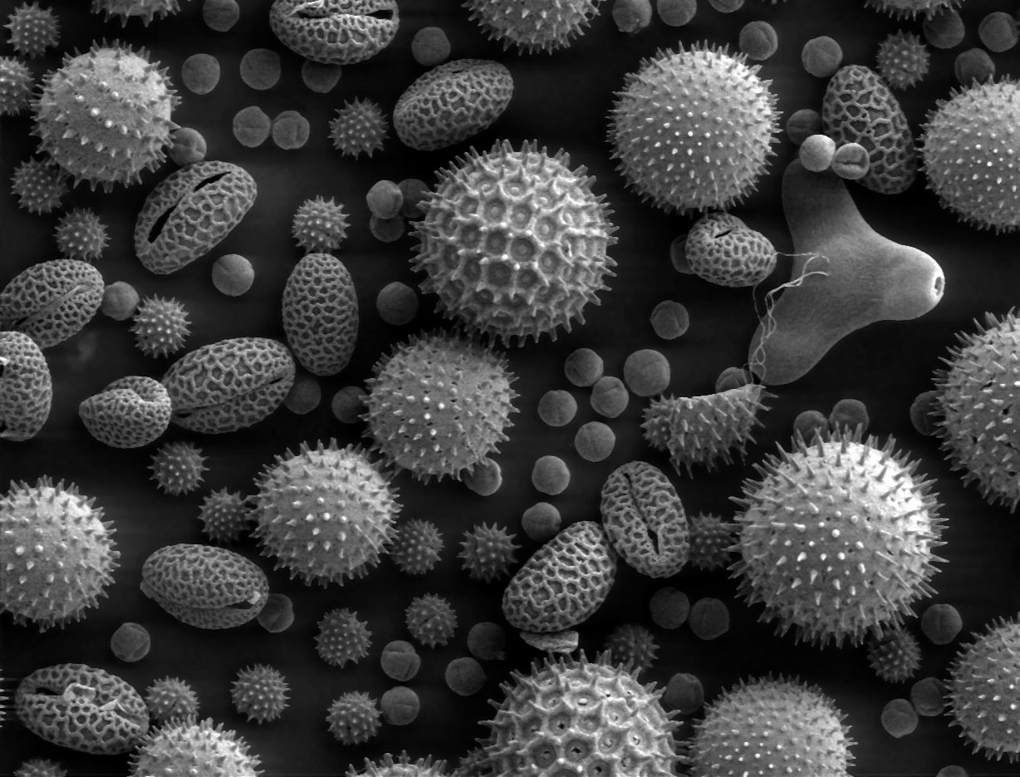
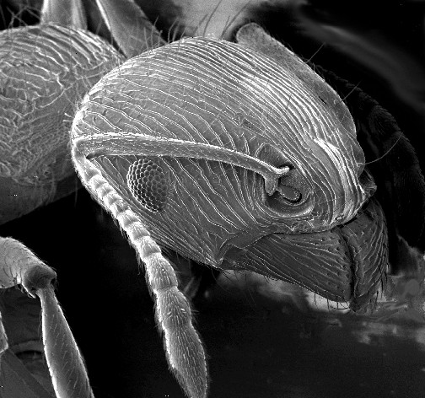
Scanning Electron Microscopes
  In scanning electron microscopes, a beam of electrons is scanned over the surface of a specimen.
  Scanning electron microscopes produce 3D images of the specimen’s surface.
pollen
ant

Slide 11
Prokaryotes and Eukaryotes
  All cells:
    Contain DNA
    Surrounded by a thin, flexible barrier called a cell membrane
  Cells are classified based on the presence of a nucleus
    The nucleus is a large membrane-enclosed structure that contains the cell’s DNA. It controls many of the cell’s activities.

Slide 12
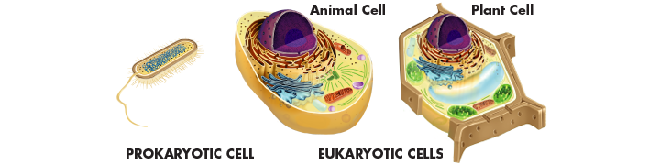
Prokaryotes and Eukaryotes
  Eukaryotes are cells that enclose their DNA in nuclei.
  Prokaryotes are cells that do not enclose DNA in nuclei.

Slide 13
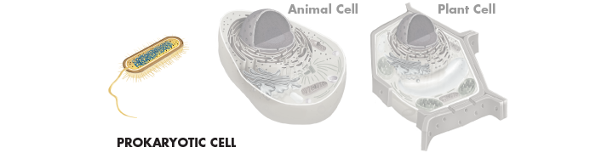
Prokaryotes
  Generally smaller and simpler than eukaryotic cells.
  Bacteria are prokaryotes.

Slide 14
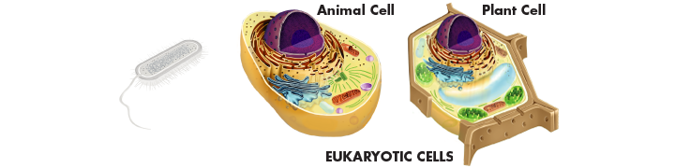
Eukaryotes
  Generally larger and more complex than prokaryotic cells.
  Most eukaryotic cells contain dozens of structures and internal membranes. Many eukaryotes are highly specialized.
  Plants, animals, fungi, and protists are eukaryotes.

Slide 15
