Slide 1
Compensation, ICP, and Stipends
Presented by the Office of Human Resources

Slide 2
What You'll be Able to Do...
Classification and Pay: Explain how job families and market ranges relate to pay.
Compensation in Voyager: Distinguish salary components in Voyager from individual compensation plans.
Confidence in Routing: Choose the appropriate request route and identify who is responsible for entering the change request.

Slide 3

Classification and Pay

Slide 4
Classification and Pay
ETSU is committed to offering fair and competitive pay, rewarding strong performance and being transparent about how compensation decisions are made.
In the summer of 2025, ETSU introduced a new classification and compensation structure to address market gaps in faculty and staff salaries. The basis of the compensation plan is to align job families with market ranges. This simplified the job classification system while still accommodating the unique roles and responsibilities across campus.

Slide 5
Classification and Pay
Job families, roles, and levels have been designed to help define the work of employees.
Each level is assigned a corresponding market range.
  Job Family: A large group of jobs that involve work in the same functional occupation
    Example: Administrative
  Role: A more narrowly defined smaller group of jobs within a larger job family that are typically in the same specific occupation
    Example: Administrative Associate
  Level: An even more narrowly defined group of jobs within the Job Family Role that have similar complexity, level of responsibility, and required education, experience and knowledge, skills, and abilities (KSAs)
    Example: Administrative Associate 3
  Market Range: Identifies the span of pay – from a minimum to a maximum – that an employer is willing to offer for a specific role; benchmarked to external data.

Slide 6
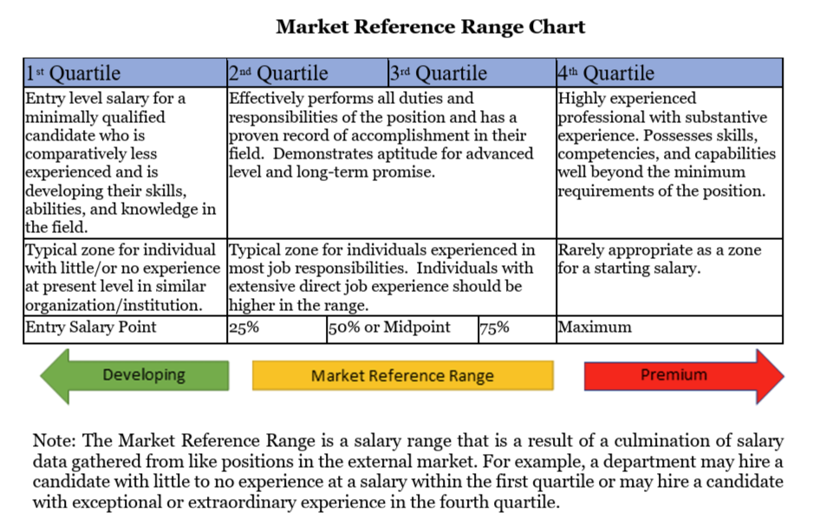
Classification and Pay

Slide 7
Classification and Pay
Position Audit
A position audit is HR’s review of an existing filled position when its duties may warrant a different classification or pay level. HR evaluates the position’s responsibilities and determines the appropriate classification.
When to request one
The position’s duties or level of responsibility have changed substantially.
Generally, a position may be audited once per fiscal year. If exceptional circumstances require another review, contact HR before changing or reassigning duties.

Slide 8
Classification and Pay
Position Pre-Audit
A position pre-audit is HR’s review of a vacant position before it is posted or filled. HR reviews the proposed duties and determines the appropriate title, classification, and market range.
When to request one
The duties of a vacant position have changed, or you plan to use the vacancy for a different role.

Slide 9
Classification and Pay
In-Range Adjustment
An in-range adjustment is a change to an employee’s base salary within the market range for their current position. The position’s job classification does not change.
When to request one
When there is a documented reason to review an employee’s pay, such as internal equity, retention, or an increase in responsibilities that does not change the position’s classification.

Slide 10
Classification and Pay
When HR Reviews a Position or Salary
Position Audit | Position Pre-Audit | In-Range Adjustment
Filled Position | Vacant Position | Position's classification stays the same.
Duties have changed substantially and may warrant a different classification or pay level. | Duties have changed or the vacancy will be used for a different role. | Employee’s base salary changes within the existing market range.

Slide 11
Classification and Pay
How to Request a Compensation Review
Complete the applicable position and compensation review form.
Email the completed form to hr@etsu.edu for processing.
HR reviews and evaluates the request and enters an approved salary change in Voyager.
* Please do not submit a separate salary change request in Voyager for these transactions.

Slide 12
Compensation in Voyager

Slide 13
Compensation in Voyager
Two Places Compensation Appears in Voyager
Current Salary (Primary Compensation) | Additional Compensation
Salary components appear in the employee’s main compensation record. They contribute to the salary displayed in Voyager. | Individual Compensation Plans (ICPs) appear under Additional Compensation. They provide pay for qualifying work outside regular duties.
First identify where the payment belongs. Then choose the process.

Slide 14
Compensation in Voyager
Salary Components form the Main Compensation Record
There are three different types of salary components
Base Salary | Administrative Stipend | At-Risk Salary
An employee always has a "base salary". The other components apply only when appropriate.

Slide 15
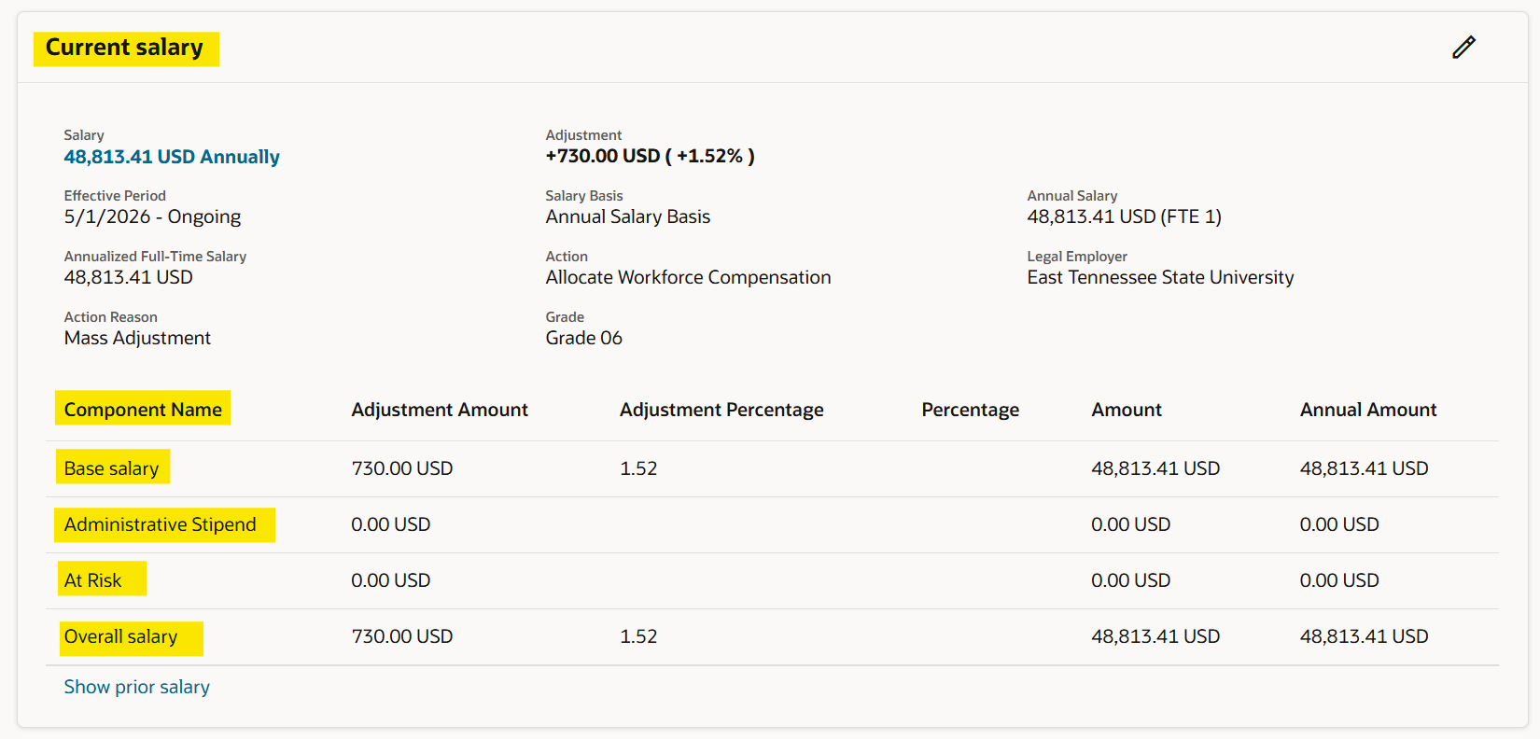
Compensation in Voyager
Example of Salary Components (On Compensation Info Screen)

Slide 16
Compensation in Voyager
Salary Component # 1: Base Salary
The employee’s regular, ongoing rate of pay for their primary position.
Base salary does not include stipends, longevity pay, or other additional compensation for temporary or additional duties.
  Additional Info:
  Part of the employee’s primary compensation.
  Ongoing until changed through an approved salary action.
  Eligible for ATB increases.

Slide 17
Compensation in Voyager
Salary Component # 2: Administrative Stipend
Additional pay for assuming administrative duties beyond the primary position.
The stipend is associated with the additional assignment and is separate from the employee’s regular base salary.
  Additional Info:
  Processed in Voyager.
  Eligible for ATB increases.
  Usually a year-long or longer – no end date in Voyager.
  Example:
    An Associate Professor receives an administrative stipend for serving as Chair of the Department of Biology.

Slide 18
Compensation in Voyager
Salary Component # 3: At-Risk Salary
A portion of a faculty member’s salary that is contingent upon available funding, typically from external sources such as grants.
If funding is not available, the at-risk portion may be reduced or discontinued.
  Additional Info:
  Processed in Voyager.
  Eligible for ATB increases.
  Contingent upon the continued availability of the designated funding source.
  Example:
    A faculty member receives $10,000 in at-risk salary for research activities funded by an external grant.
      The $10,000 remains part of the faculty member’s salary while funding is available but may be removed if the grant funding ends.

Slide 19
Compensation in Voyager
Individiual Compensation Plans (ICPs) pay for additional work
An ICP provides additional compensation outside regular salary.
The work may only occur once or may continue for a limited period.
ICPs must be submitted in Voyager unless funded by a different department.
ICPs cannot be backdated in Voyager and are not eligible for ATB increases.

Slide 20
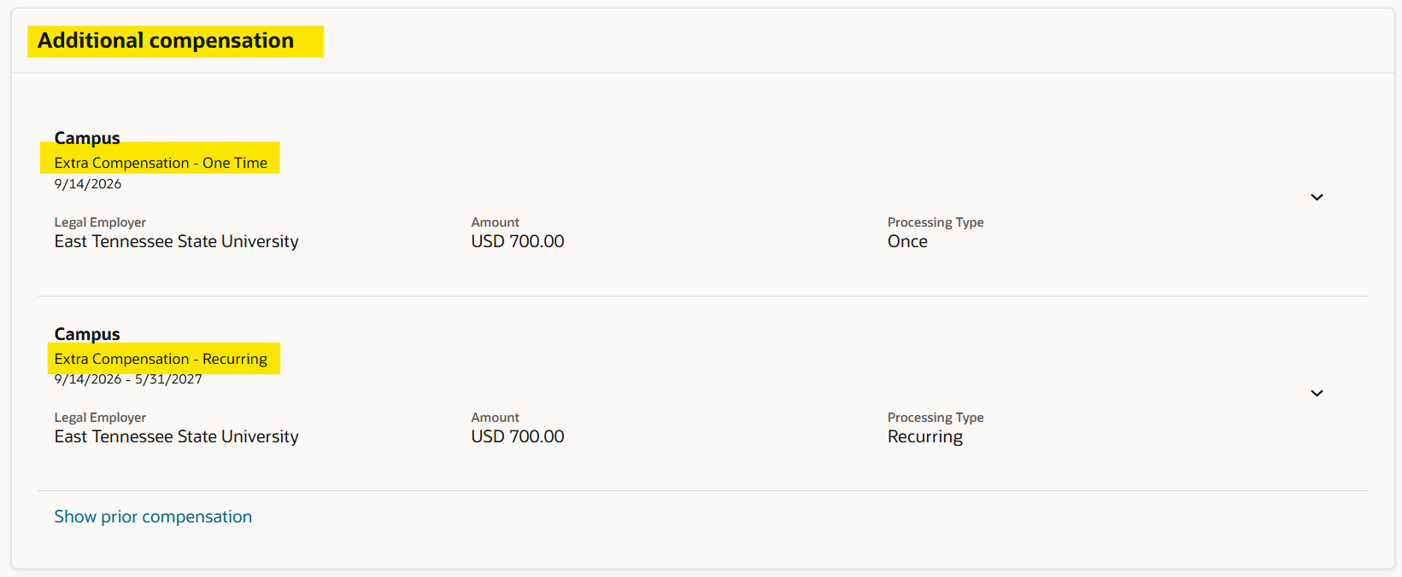
Individual Compensation Plans
Example of ICP

Slide 21
Compensation in Voyager
Three common ICP payments
Additive Stipend | One-Time Extra Compensation | Recurring Extra Compensation
A temporary added duty paid as a stipend. Set an end date. | A single payment for an activity outside of normal duties. | Pay for additional work over several pay periods.
Example: A faculty member is designated as "Acting Chair" for one semester. | Example: A faculty member completes a guest lecture outside of their typical course load. | Example: A faculty member leads a semester of community health workshops.

Slide 22
Compensation in Voyager
Who enters the ICP in Voyager?
Campus Representatives | Human Resources
Enter the campus-assigned ICP plans in Voyager and follow the applicable approval workflow. | HR enters the plans assigned to HR. Confirm plan ownership before submitting if unclear.
Submit related ICPs for one employee in the same transaction when appropriate.

Slide 23
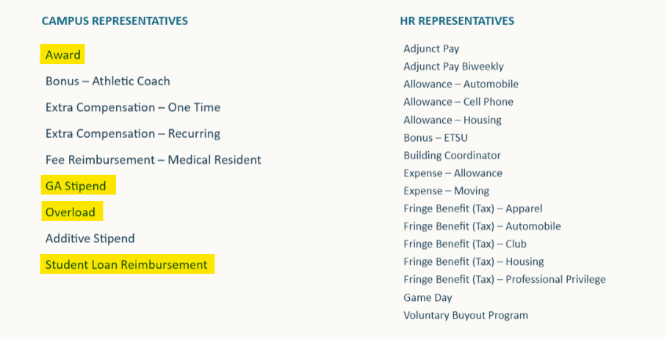
Individual Compensation Plans
Types of ICPs and Who Enters Each Plan in Voyager

Slide 24

Compensation in Voyager
Individual Compensation Plan (ICP) demo

Slide 25
Compensation in Voyager
Administrative stipends vs. Additive stipends
Duration and duties guide the review.
Ask HR about special circumstances.
Administrative Stipend | Additive Stipend
Salary component | ICP under Additional Compensation
Administrative assignment | Temporary added duties
Generally a year or longer No end date | Limited duration Has an end date
Eligible for ATB increases | No ATB increase

Slide 26
Compensation in Voyager
Which payment fits?
Primary position duties and ongoing pay: Base Salary
Additional administrative role as part of salary: Administrative Stipend
Faculty salary dependent on designated funding: At-Risk Salary
One activity beyond normal duties: One-Time Extra Compensation
Additional work over several pay periods: Recurring Extra Compensation
Temporary added duty paid as a stipend: Additive Stipend
When in doubt, contact HR before submitting.

Slide 27
Compensation in Voyager
When another department funds extra compensation
Submit the ICP through Dynamic Forms. This is still required when another department funds the payment.
The budget authority for the employee’s home department must also create an element labor schedule using the chart of accounts string provided by the funding department.
Payment Type | Element for the Labor Schedule
Single Payment | Extra Comp Earnings Results
Recurring Payment | Extra Comp Recurring Earnings Results

Slide 28
Compensation in Voyager
Request routes at a glance
Voyager | HR Review Form | Dynamic Forms
Administrative appointments | Position audits | ICPs funded by other departments
At-risk salary | Position pre-audits | *
ICPs | In-range adjustment requests | *
CAP certification increases | * | *

Slide 29
Compensation in Voyager
Before submitting a request, consider...
Is this part of regular salary or pay for work outside normal duties?
Is the duty permanent, temporary, or a one-time activity?
Does the payment need an end date?
Which department is funding it?
Is the route Voyager, Dynamic Forms, or an HR review form?

Slide 30
Quick Guide for Processing
Processed in Voyager:
Administrative Appointments
At-Risk Salaries
ICPs
CAP Certification Increases (This is a recent change)
Processed Outside of Voyager:
Audits
Pre-Audits
In-Range Adjustment Requests
ICPs funded by other departments

Slide 31

Questions and support
Please contact the Office of Human Resources:
Phone: (423) 439-4457
Email: hr@etsu.edu

